Slide 1
Canadian Satellite Design Challenge CSDC-4 Critical Design Review
Queen’s Space Engineering Team (QSET)
Bryan Little, Matthew Bowen, James Xie
Sept. 21, 2017

Slide 2
Presentation Outline
Mission Overview
Spacecraft Overview
Payload(s) Description
Structure
Thermal
Power
Attitude & Orbit Determination & Control
Communications
Command & Data Handling
Assembly, Integration, and Test
Programme Management
Concept of Operations
Educational Outreach
Summary

Slide 3
Mission Overview

Slide 4
Mission Summary
Problem
Experiment
Subject space-grade materials to orbital decay
Measure spectral reflectance change over time
Result
Material reflectance behavior in space is now known
SSA community determines what each object is
Must understand material spectral changes over time
Orbital object identification using their spectra
PRIMARY MISSION
Problem
Experiment
Mount green & red LEDs to external panels
Result
CCD camera used to determine wavelength of LED or;
Visual communication
Satellite cluster identification
Flash either green or red LEDs while over ground station
Receive low-bandwidth data from Morse code blinking
SECONDARY MISSION

Slide 5
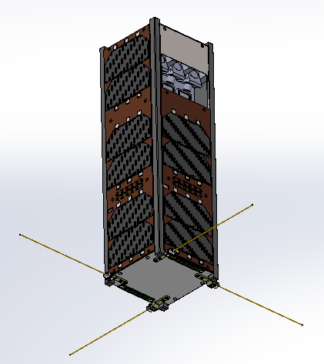
Spacecraft Summary
Z⁺
Y⁺
Spectral Slot
X⁺
Nadir over Kingston
LEDs
Solar cells
Antennas

Slide 6
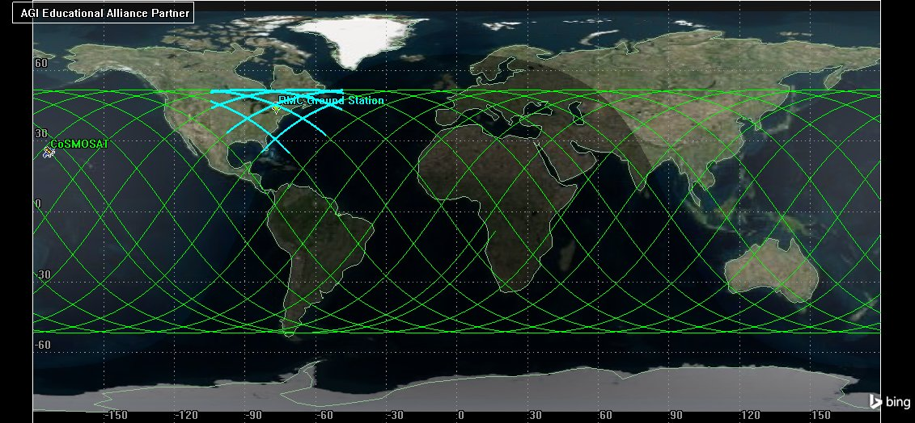
Mission Ground Track and Ground Station Access (1/2)
Notes:
July 1st, 00h00 to July 2nd, 00h00

Slide 7
Mission Ground Track and Ground Station Access (2/2)
Ground Station:
Royal Military College of Canada SSRL
44°14’1.97” N, 76°28’3.02” W
Passes per day:
Minimum: 6
Average: 6.8
Daily contact time:
Minimum: 58.4 minutes
Average: 64. 6 minutes

Slide 8
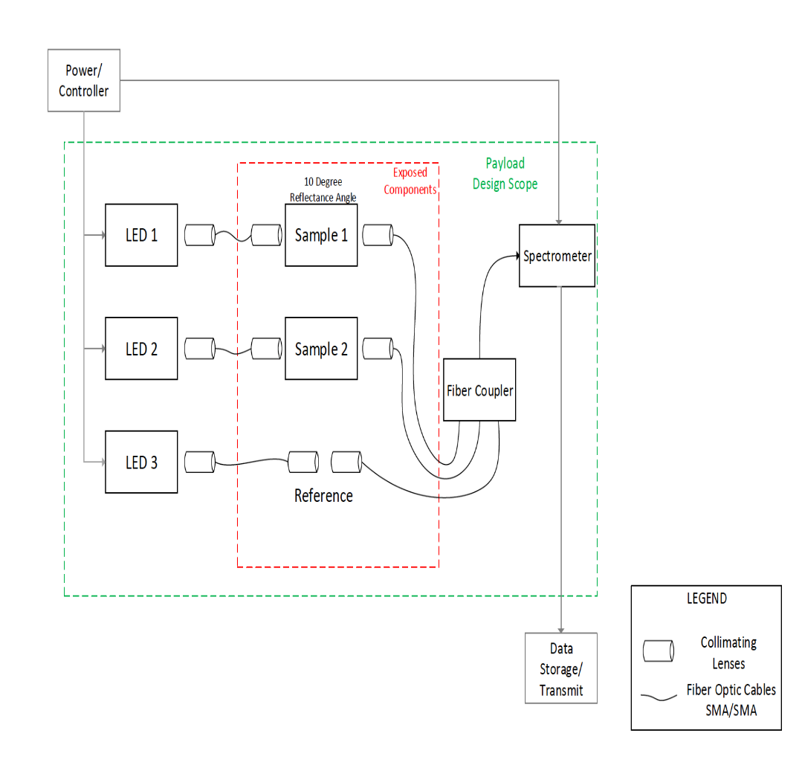
Changes to Payload 1 Since PDR – Original Design

Slide 9
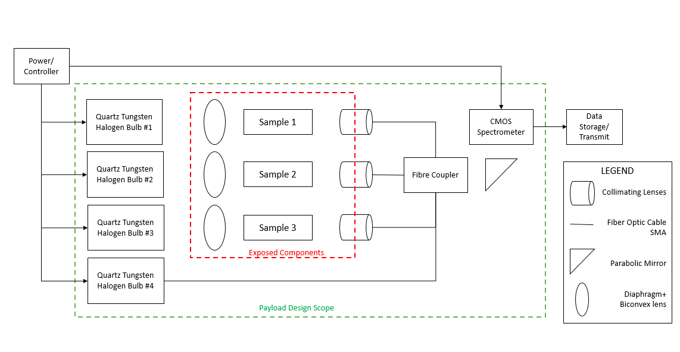
Changes to Payload 1 Since PDR – Updated Design
Aspheric Lens
Notes:
LED banks substituted for quartz tungsten-halogen lamp
Simpler electronics (less crowding, more throughput), more uniform spectra
Increased samples from 2 to 3 in addition to reference
Change of observation angle from 10º to 60º
Increased exposure area and better protection of optics
Combination of fiber optic and free space assembly
Reduction of complexity and error
Overall refinement of design to match ground-based lab settings

Slide 10
Spacecraft Overview

Slide 11
System Level Configuration Trade Selection
Build
Chosen to design subsystems in areas where members possess expertise
Team involves graduate students with specialized skill sets
FEM, Mechanical Design Optimization, RF design
Parts manufactured in-house will undergo rigorous qualification
Spectrometer system (TRIUMF), ACDS (Engineering Physics Department), Structure (Vibration and Noise Laboratory)
Buy
Subsystems requiring extensive background knowledge to build from the ground up
Preference given to flight heritage components

Slide 12
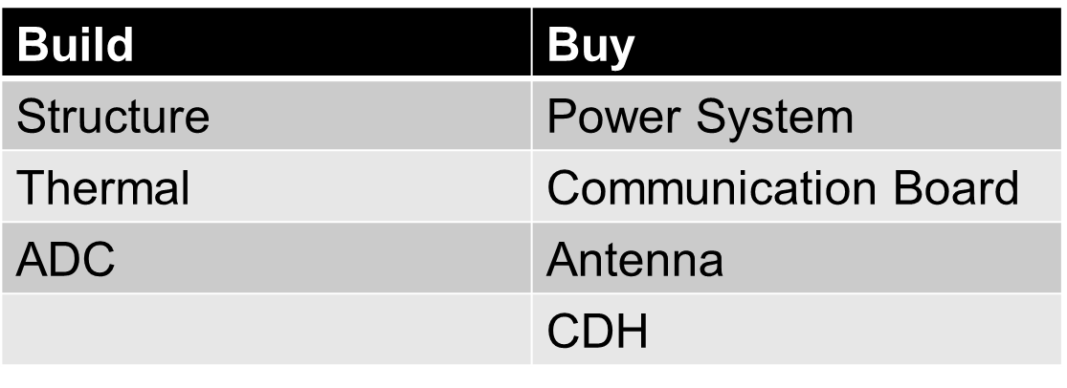
System Level Configuration Trade Selection
Structure
Team has strong background in mechanical design
Freedom to customize structure to accommodate unconventional payload
Fraction of the cost of a ready-made structure
Discounted shop rates (for parts requiring specialized milling) and raw material costs

Slide 13
System Level Configuration Trade Selection
Thermal
Sponsorship discount from company producing MLI kits
Insulation requirement being evaluated; dependent on outcome of thermal simulations
If purchased, implementation would be planned and applied by thermal team

Slide 14
System Level Configuration Trade Selection
ADC
Neither payload requires active control
Many theses/journal papers detailing research and application of passive control systems
Position and layout of magnets/ hysteresis rods
Passive attitude control cannot be directly purchased regardless

Slide 15
System Level Configuration Trade Selection
ADC (cont’d)
Passive system saves cost of actuators and controller (thousand dollar range)
Possess calibration equipment to measure and tune response of permanent magnets and dampers
Design of sun-sensor system and CDH programs to determine acceptable attitude

Slide 16
System Level Configuration Trade Selection
Power System
Have background to configure and tune final product to the needs of the satellite bus/payloads
Do not possess resources to fabricate PCBs in house
Especially with regards to validation for spaceflight
E.g, Conformal coating, verified fail-safe operation

Slide 17
System Level Configuration Trade Selection
Power System
Supplier | Part Name | Native Cost | Cost (CAD) | Notes
NanoAvionics | EPS | 3000 EUR | 4505.00 | Includes batteries, coarse sun sensing, Price in Euro (Additional levys, duties)
ASTERLabs | NanoPowerP31uX | 4600 USD | 5808.00 | No batteries, Price in USD

Slide 18
System Level Configuration Trade Selection
Communication System and Antenna
Purchasing antenna and communications board from same company ensures compatibility
Eliminating subsystem design in these areas
Strictly configuration, testing, and integration

Slide 19
System Level Configuration Trade Selection
Communication System
Supplier | Part Name | Native Cost | Cost (CAD) | Notes
NanoAvionics | UHF Digital Radio SatCOM UHF | 4500.00 Euro | 6758.00 | Price in Euro
ASTERLabs | NanoCom AX100-U | 7250.00 USD | 9155.00 | Price in USD

Slide 20
System Level Configuration Trade Selection
Antenna
Supplier | Part Name | Native Cost | Cost (CAD) | Notes
NanoAvionics | UHF/VHF Antenna | 2500 | 3754.61 | Price in Euro
ASTERLabs | NanoCom ANT430 | 6250 | 7892.25 | Price in USD

Slide 21
System Level Configuration Trade Selection
Command and Data Handling
Decision to purchase generic embedded system
Not specifically designed for Nanosatellites, but robust enough to handle harsh environment
Large cost reduction over satellite part provider
Chosen board, accessories, and support received free of charge from Technologic Systems (TS-7600)
Hard/Software capable of handling payloads, network routing, data I/O, subsystem interfacing

Slide 22
System Level Configuration Trade Selection
Command and Data Handling
Features
1.2W Max, Watchdog timer, 8 Serial Ports, SPI, I2C, CAN, RTC, 10/100 Ethernet, microSD socket
Name | CPU | RAM | Storage | DAC | Kernel
TS-7600 | 454MHZ, ARM | 256MB | 8MB | 55 DIO 4 A2D | Linux v2.6.35

Slide 23
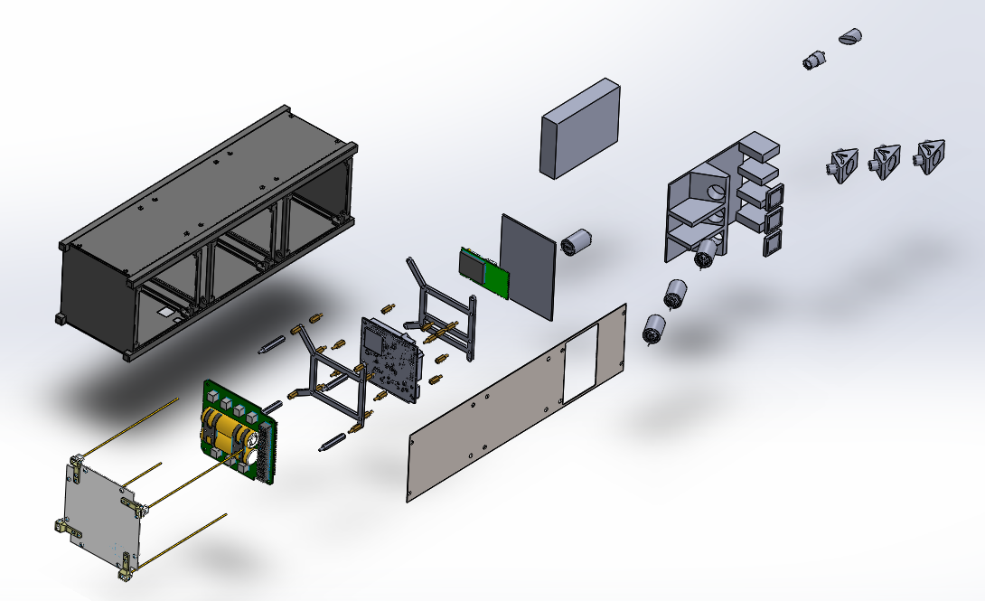
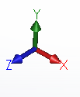
Physical Layout
Spectrometer
Sample Stage
Collimating Lenses
Sample Material
Transceiver
Tungsten Halogen Bulbs
OBC
EPS/Batteries
Antennas

Slide 24
Payloads

Slide 25
Payload #1: Material Degradation in Space
CoSMOSAT monitors time-dependent degradation of common spacecraft materials via reflectance spectra
Augments ground-based data to identify the composition, orientation, and age of debris ^{[P1, P2]}
Reflection spectroscopy is cost-effective
Addresses knowledge gap of how material reflectance changes over time in space environments ^{[P1]}
Ground observations are impractical to generate data
Requires fine control of reflection geometry, age knowledge, and has limitations of telescope usage time and weather ^{[P1]}
Cannot distinguish individual materials
Lab experiments cannot efficiently and accurately recreate long exposure to the complex LEO environments ^{[P1]}

Slide 26
Payload #1: Material Degradation in Space (cont.)
Payload compresses large-scale lab experiment into a 1U compartment
Unique experiment provides first time-evolving data on material degradation ^{[P1]}
Extends existing data and augments ground-based observations, allowing them to be used in space applications
Payload is a joint project between Queen’s University and Royal Military College, and builds off of Major Donald Bédard’s work.
Collected data will be used by researchers and the space industry in space situational awareness (SSA) ^{[P1]}
Provides more granularity than the NASA Long-Duration Exposure Facility (LDEF) experiments ^{[P1]}
Notes:
What is new or innovative about this payload experiment?

Slide 27
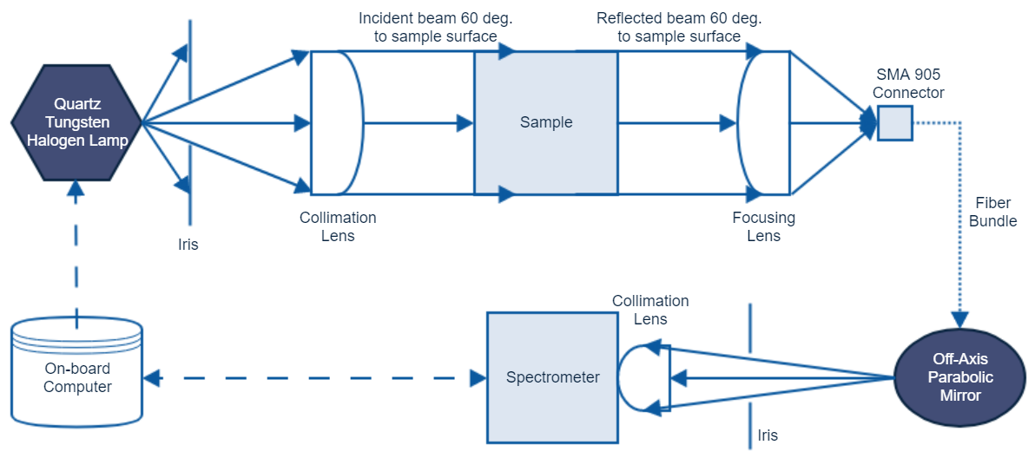
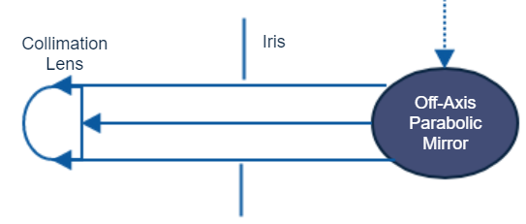
Payload #1: Physical Characteristics
Physical Size | Total Mass | Data Throughput
1400 cm³ | 870 g | 125 kB/day

Slide 28
Payload #1: Performance Characteristics
Record spectra of 3 samples exposed to the space environment and one reference
Spectra range of 400–1100 nm @ 2.35 nm resolution ^{[P3]}
Sampling in eclipse when light level drops below 1% reference signal strength
No requirements on orbital position or attitude.
In eclipse/sufficient darkness, on-board lighting will be used
Otherwise, the sun may act as a light source, with illumination geometry calculated on the ground via attitude data ^{[P1]}
Notes:
Objective coverage characteristics & statistics
E.g., Earth imagery in km²/day
What attitude and orbit position accuracy does your payload need? What happens if it doesn’t get that?

Slide 29
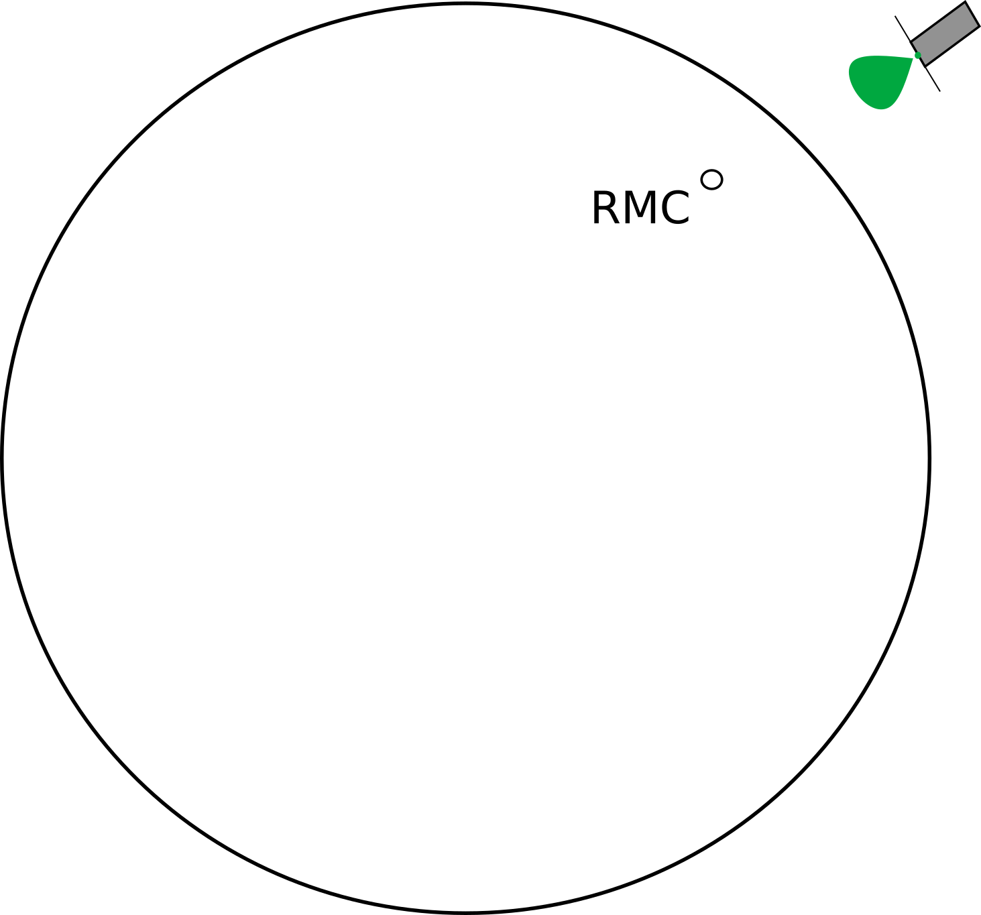
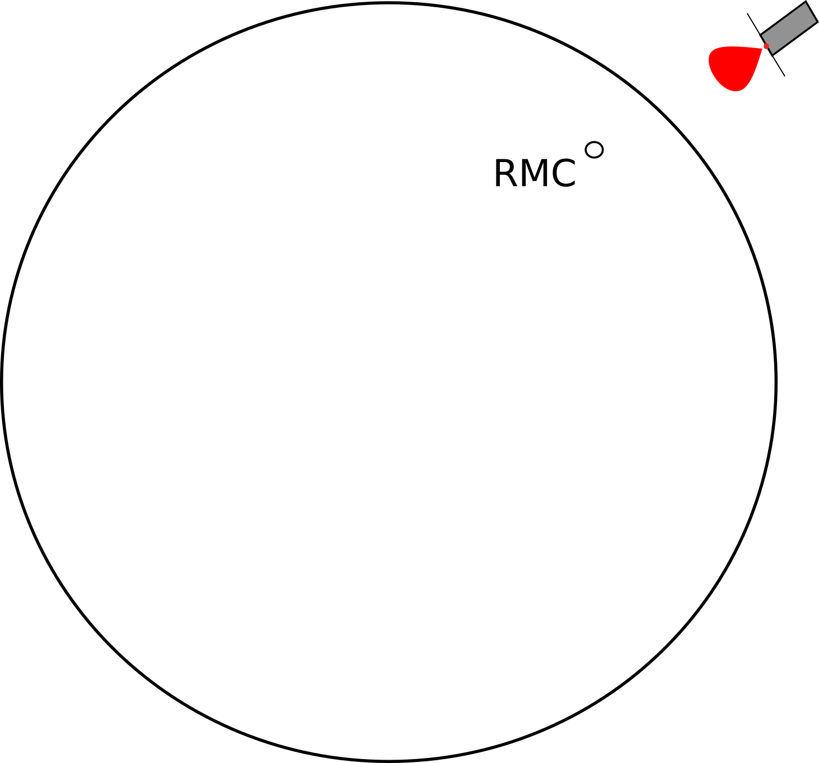
Payload #2 – Satellite Identification via VLC (LEDSAT)
Clusters of nano-satellites can be difficult to identify
Externally-mounted LEDs may be used
Satellite-to-ground Visual Light Communication (VLC)
Upon deployment, LEDs are initiated when over Kingston during eclipse
Astronomical camera with CCD attached to RMC telescope for wavelength identification
Telescope, CCD with John-Cousins Filters

Slide 30
Payload #2 – LEDSAT (cont.)
Why should it be put into space?
Identification of nano-satellites without operator communication
Can LED wavelength be determined from 400-1200 km away through Earth’s atmosphere? How do LEDs degrade under radiation over time?
What is innovative about this payload?
Identification using both LED wavelength and blinking schemes
Ability to function while tumbling and stabilized
Partners
RMC is initiating a project to standardize external LEDs for CubeSats
May also be used for educational outreach

Slide 31
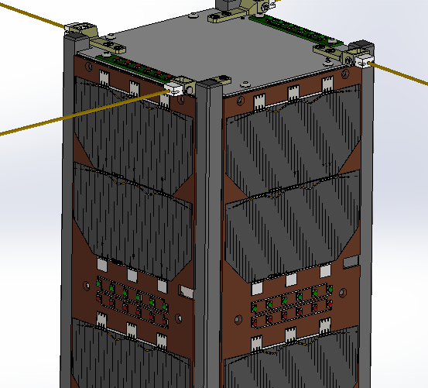
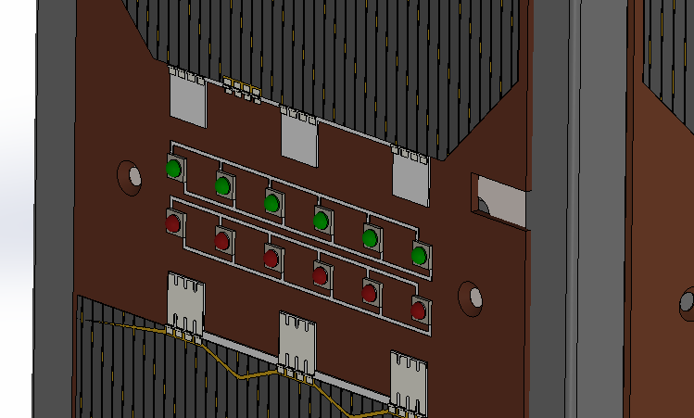
Payload #2 - LEDSAT: Characteristics
-z
6 green LEDs & 6 red LEDs on +X,+Y,-X,-Y,-Z faces

Slide 32
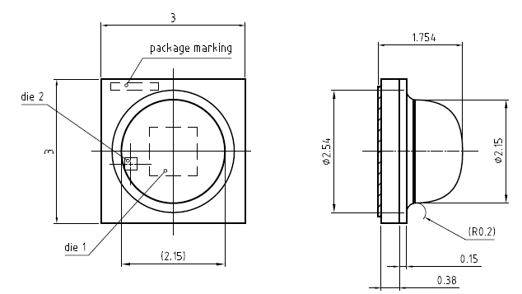
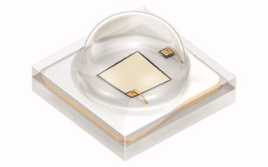
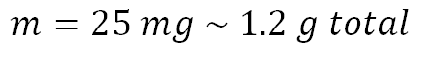
Payload #2 - LEDSAT: Characteristics
x48
$$m=25 mg \sim 1.2 g total$$
Dimensions in mm
 | Wavelength (nm) | Forward Current (A) | Forward Voltage (V) | Luminous Flux (lm) | Radiant Flux (W) | (FWHM) | Operating Temperature (°C)
Red | 620-635 | 0.35 | 3.00 | 56.8 | 0.3737 | 62.5 | -40/+80
Green | 513-543 | 0.35 | 3.35 | 130 | 0.2440 | 60 | -40/+80

Slide 33
References
[P1] | D. Bedard, A. Willison, P. Seitzer and P. Somers, "In-Situ VIS/NIR Measurements of Space Environment Effects on Spacecraft Surfaces," in AMOS Technologies Conference, Maui, Hawai'i, 2016.
[P2] | Donald Bedard, Gregg A. Wade, and Kira Abercromby, “Laboratory Characterization of Homogenous Spacecraft Materials,” Journal of Spacecraft and Rockets, vol. 52, no. 4, pp. 1038–1054, 2015.
[P3] | Avantes BV, “AvaSpec-Mini.” Avantes BV, 2017.
[P4] | Donald Bedard and Martin Levesque, “Analysis of the CanX-1 Engineering Model Spectral Reflectance Measurements,” Journal of Spacecraft and Rockets, vol. 51, no. 5, pp. 1492–1504, 2014.
[P5] | T. Kiuchi and K. Ikeuchi, "Determining the Surface Roughness and Shape of Specular Diffuse Lobe Objects Using Photometric Sampling Device," IAPR Workshop on Machine Vision Applications , pp. 175-178, 7-9 December 1992.
[P6] | Thorlabs Inc., “Quartz Tungsten-Halogen Lamp.” Thorlabs Inc., 2017.
[P7] | S. K. Miller, "Degradation of Spacecraft Materials in the Space Environment," MRS Bulletin, vol. 35, January 2010.

Slide 34
Spacecraft Structure

Slide 35
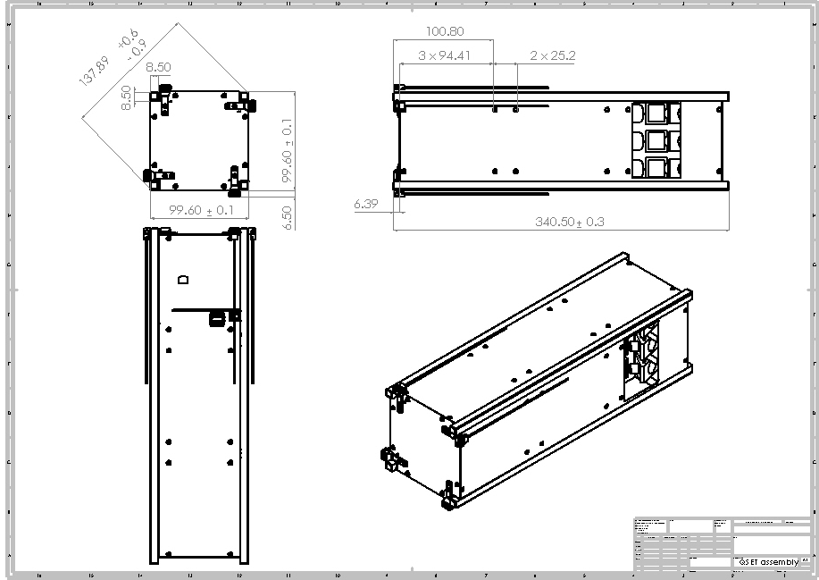
Spacecraft Structural Drawings
All Dimensions
In mm

Slide 36
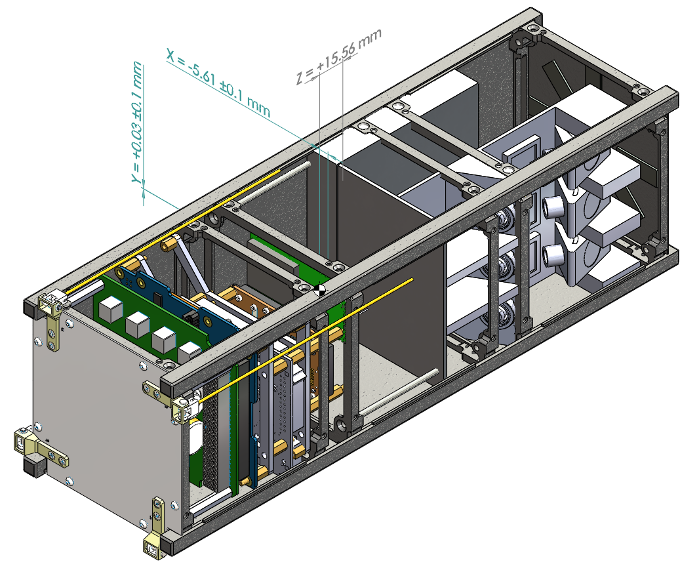
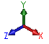
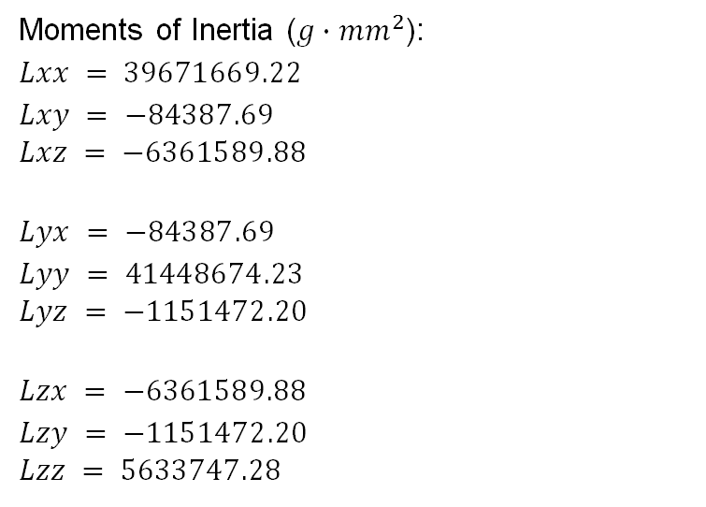
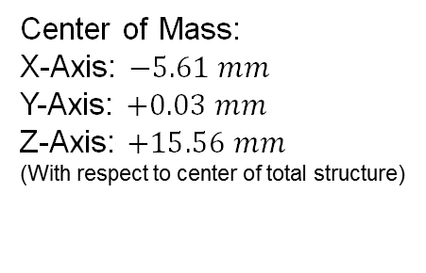
Structural
Involved
Start
Center of Mass:
X-Axis: $−5.61 mm$
Y-Axis: $+0.03 mm$
Z-Axis: $+15.56 mm$
(With respect to center of total structure)
Moments of Inertia ($g∙{mm}^{2}$):
$$Lxx = 39671669.22$$
$$Lxy = −84387.69$$
$$Lxz = −6361589.88$$
$$Lyx = −84387.69$$
$$Lyy = 41448674.23$$
$$Lyz = −1151472.20$$
$$Lzx = −6361589.88$$
$$Lzy = −1151472.20$$
$$Lzz = 5633747.28$$
[DIETR-0320] Launch Vibration Test

Slide 37
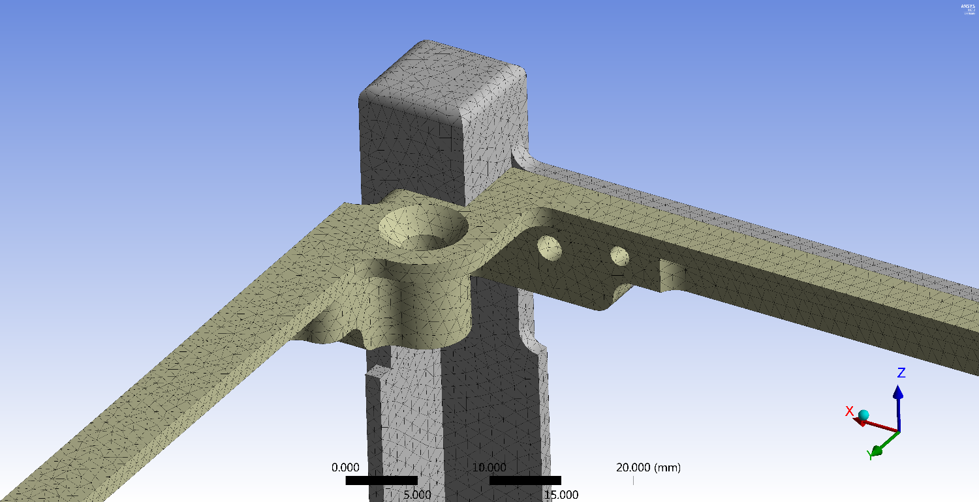
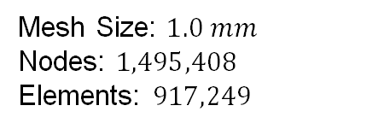
Structural
Involved
Start
Mesh Size: $1.0 mm$
Nodes: $1,495,408$
Elements: $917,249$
[DIETR-0320] Launch Vibration Test

Slide 38
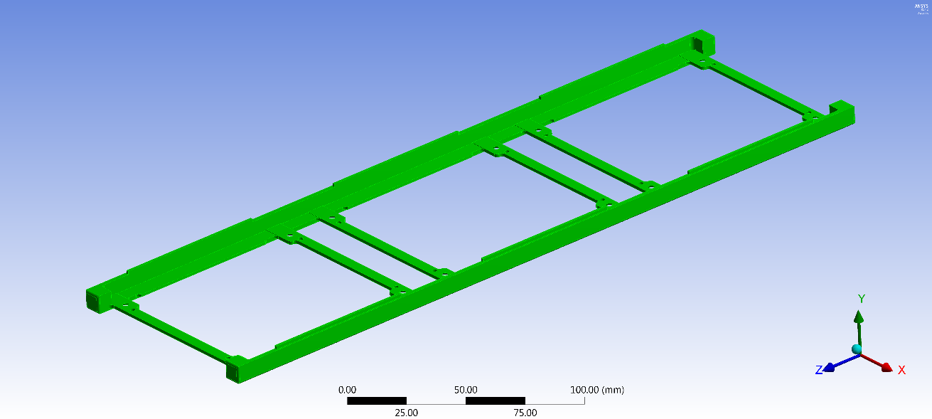
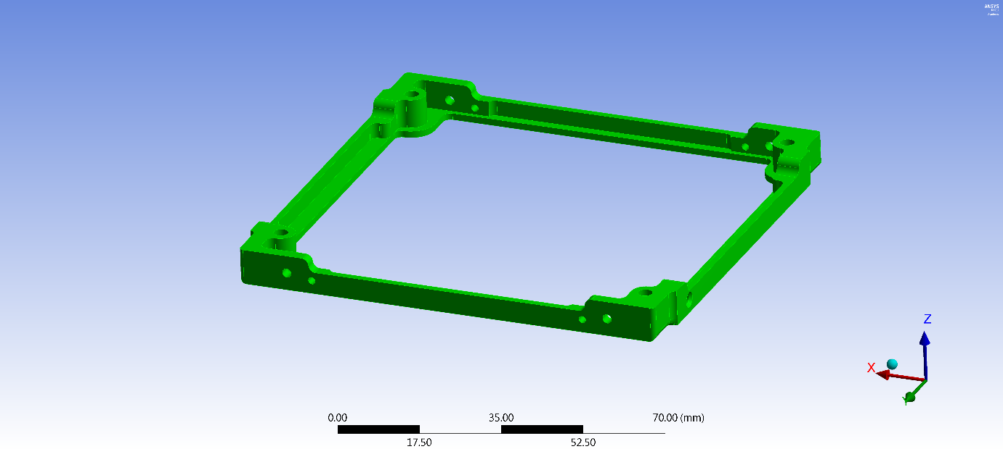
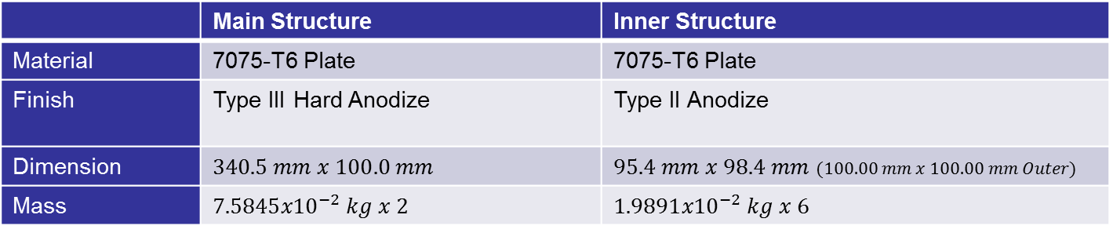
Structural – Frame Material
Involved
Start
 | Main Structure | Inner Structure
Material | 7075-T6 Plate | 7075-T6 Plate
Finish | Type III Hard Anodize | Type II Anodize
Dimension | $$340.5 mm x 100.0 mm$$ | $95.4 mm x 98.4 mm$ $(100.00 mm x 100.00 mm Outer)$
Mass | $$7.5845{x10}^{−2} kg x 2$$ | $$1.9891{x10}^{−2} kg x 6$$

Slide 39
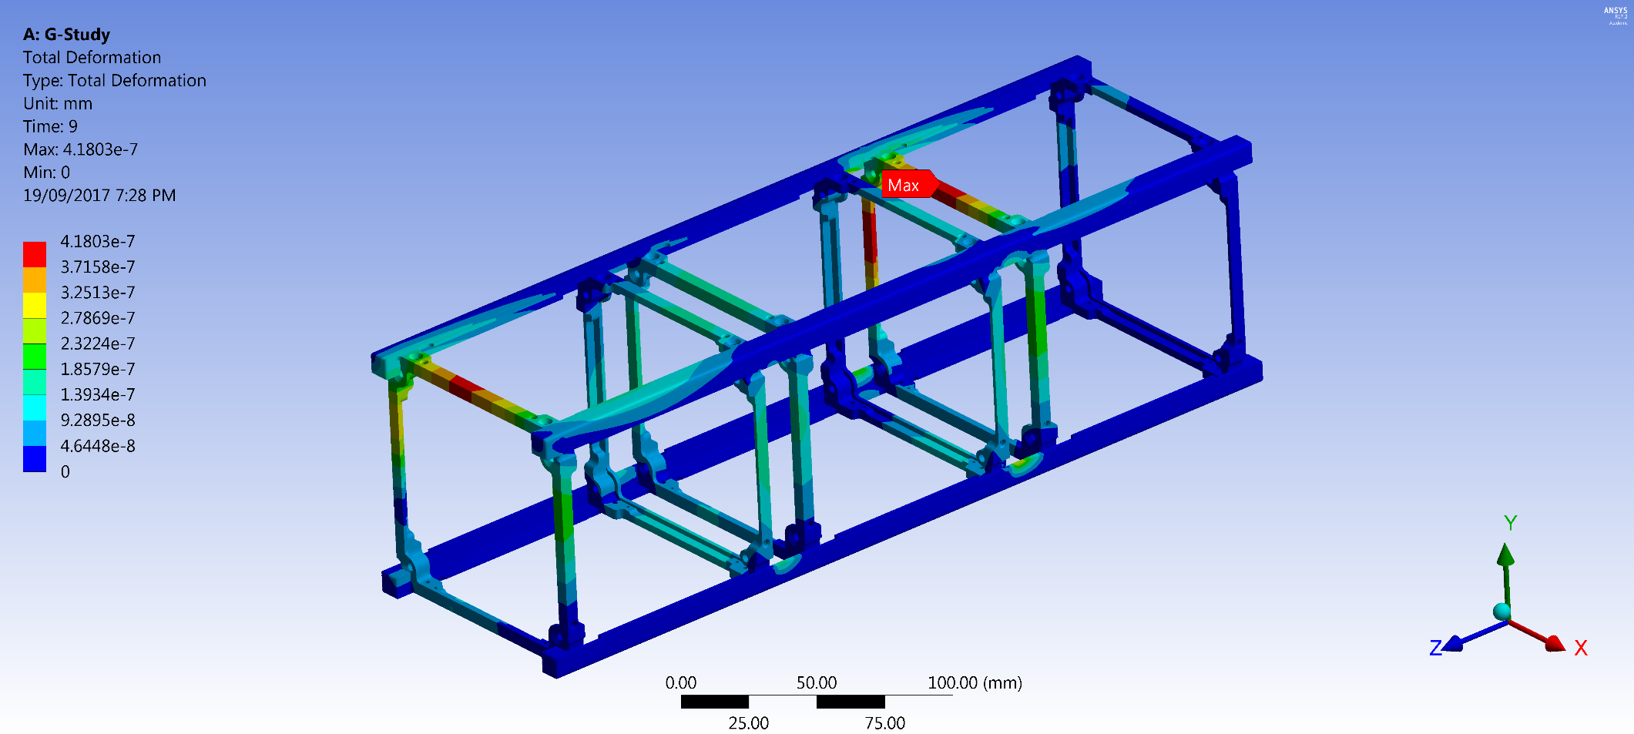
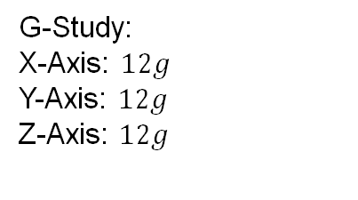
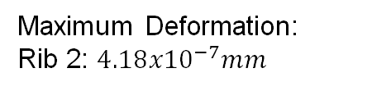
Structural – Spacecraft Static Analysis
Involved
Start
G-Study:
X-Axis: $12g$
Y-Axis: $12g$
Z-Axis: $12g$
Maximum Deformation:
Rib 2: $4.18{x10}^{−7}mm$
[DIETR-0310] Launch Quasi-static Acceleration Test

Slide 40
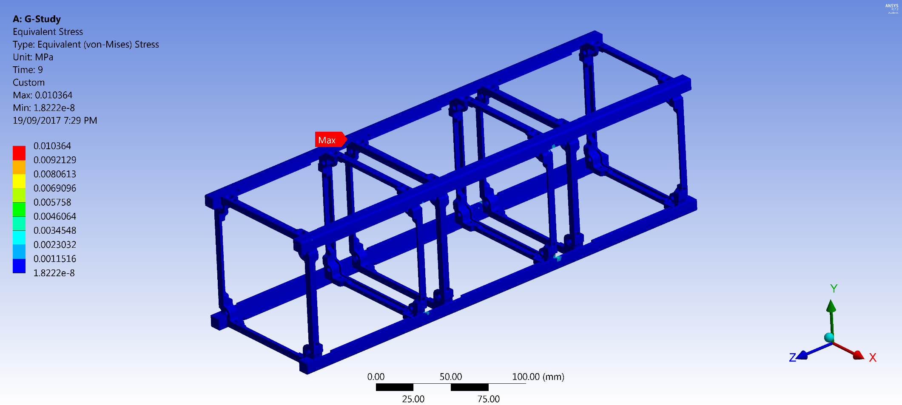
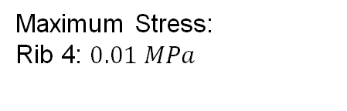
Structural – Spacecraft Static Analysis (cont.)
Involved
Start
G-Study:
X-Axis: $12g$
Y-Axis: $12g$
Z-Axis: $12g$
Maximum Stress:
Rib 4: $0.01 MPa$
[DIETR-0310] Launch Quasi-static Acceleration Test

Slide 41
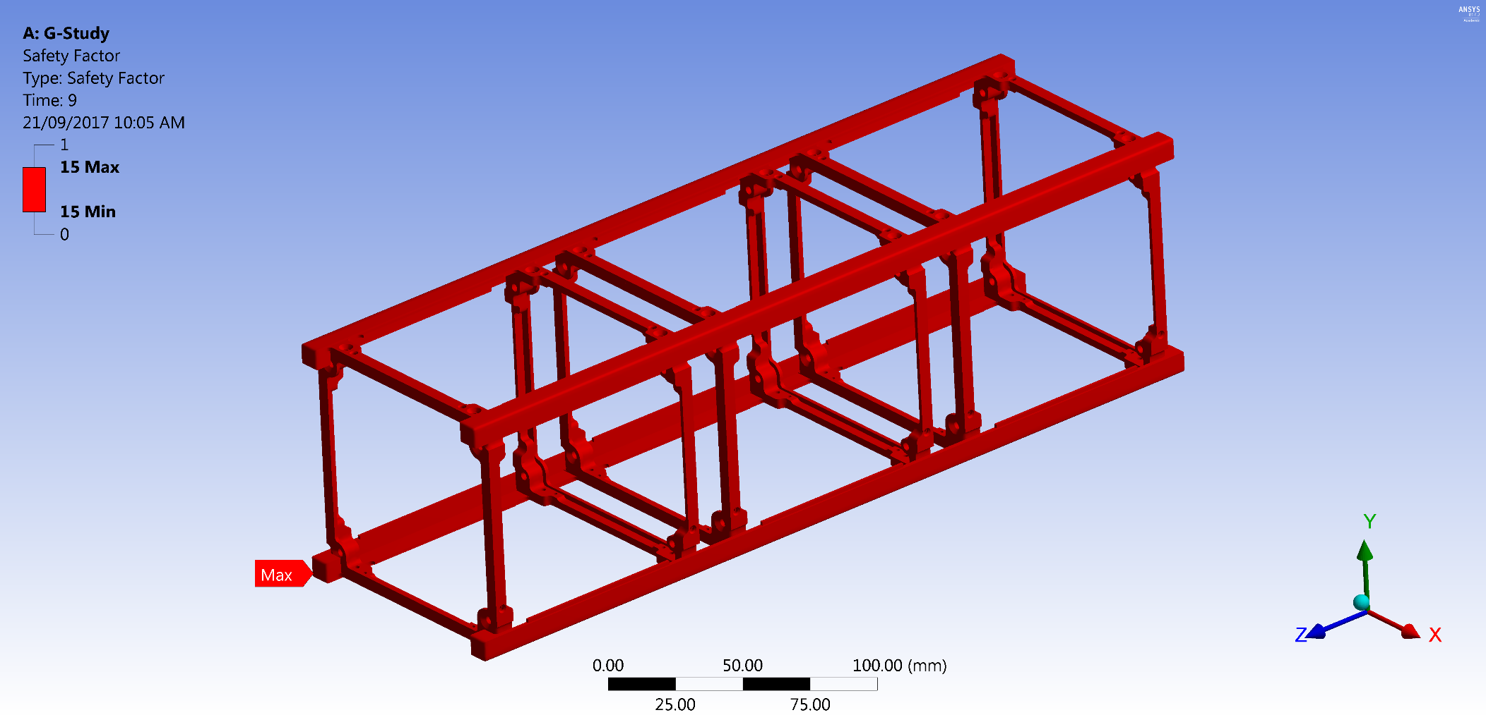
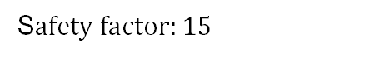
Structural – Safety Factor
Involved
Start
G-Study:
X-Axis: $12g$
Y-Axis: $12g$
Z-Axis: $12g$
S$afety factor:15$
[DIETR-0310] Launch Quasi-static Acceleration Test

Slide 42
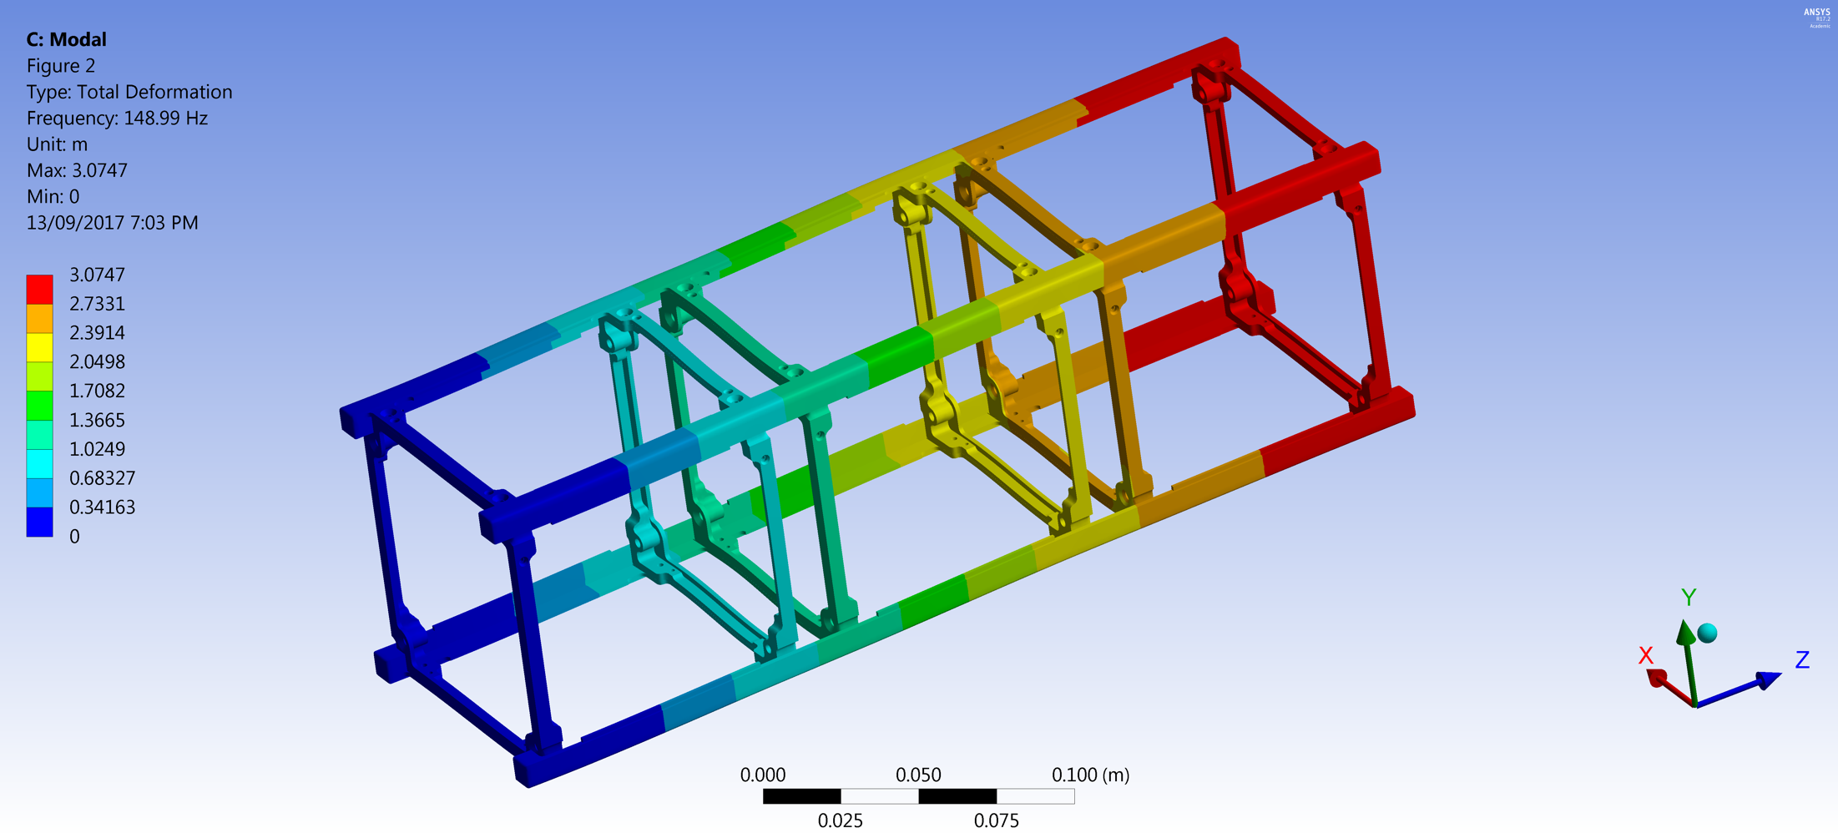
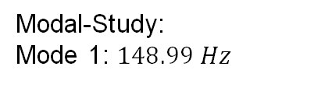
Structural – Normal Modes Analysis
Involved
Start
Modal-Study:
Mode 1: $148.99 Hz$
[DIETR-0200] Fundamental Frequency

Slide 43
Structural
Involved
Start
Modal-Study:
Mode 1: $148.99 Hz$
[DIETR-0200] Fundamental Frequency

Slide 44
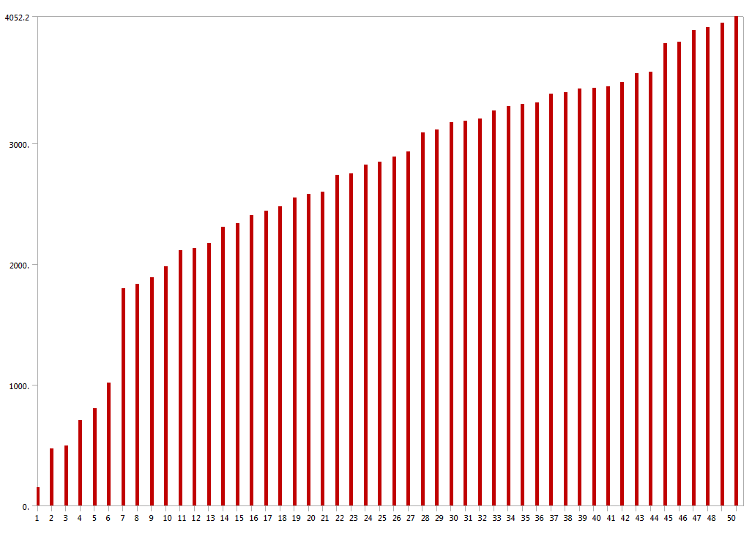
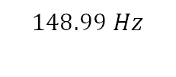
Structural – Normal Modes Analysis (cont.)
Involved
Start
$$148.99 Hz$$
Modal-Study: First 50 Modes of vibration
[DIETR-0200] Fundamental Frequency

Slide 45
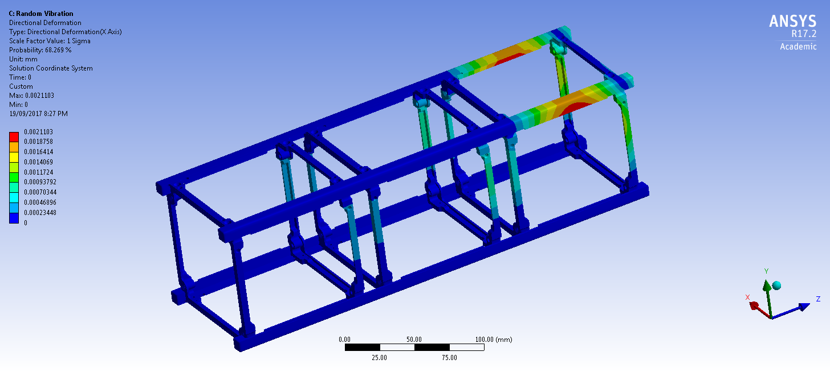
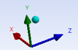
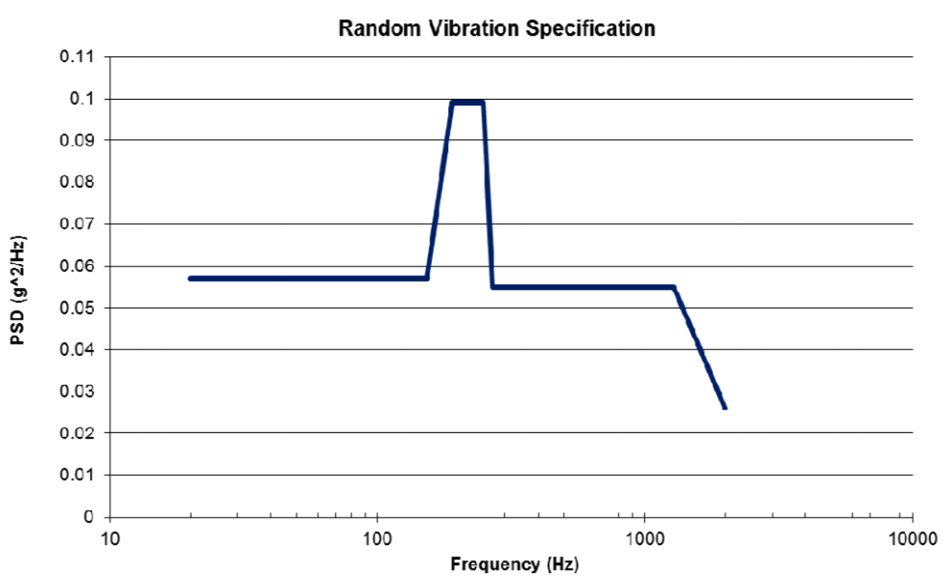
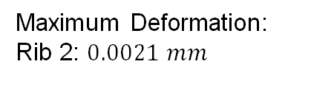
Structural – Launch Vibration Study
Involved
Start
Launch Vibration-Study: X-Axis
Maximum Deformation:
Rib 2: $0.0021 mm$
[DIETR-0320] Launch Vibration Test

Slide 46
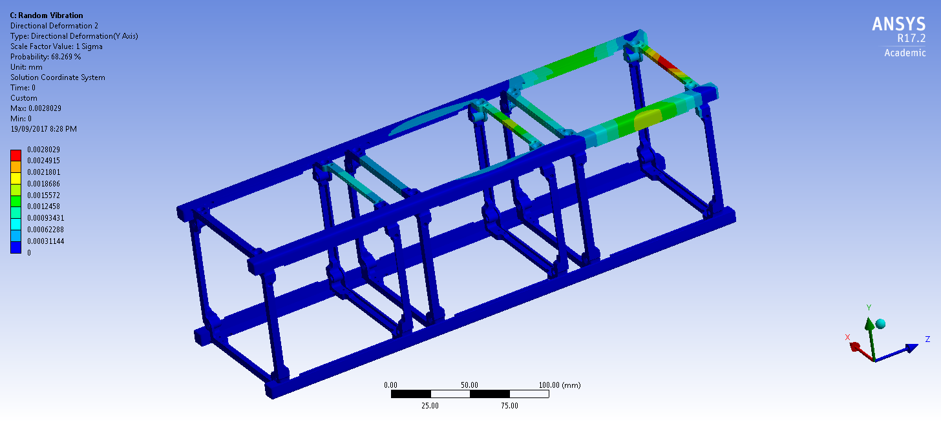
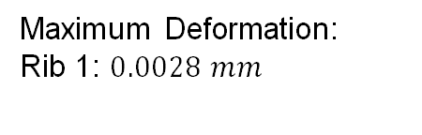
Structural – Launch Vibration Study (cont.)
Involved
Start
Launch Vibration-Study: Y-Axis
Maximum Deformation:
Rib 1: $0.0028 mm$
[DIETR-0320] Launch Vibration Test

Slide 47
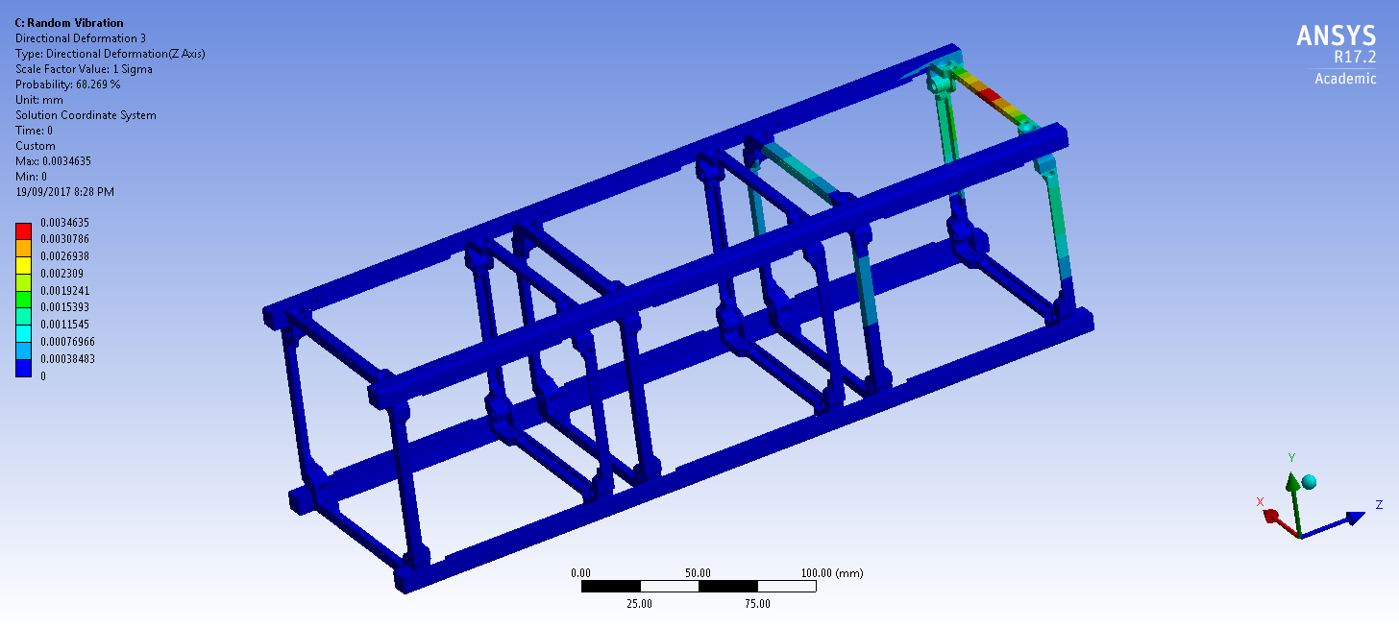
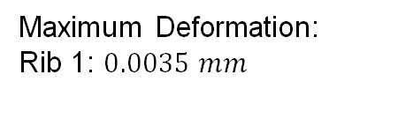
Structural – Launch Vibration Study (cont.)
Involved
Start
Launch Vibration-Study: Z-Axis
Maximum Deformation:
Rib 1: $0.0035 mm$
[DIETR-0320] Launch Vibration Test

Slide 48
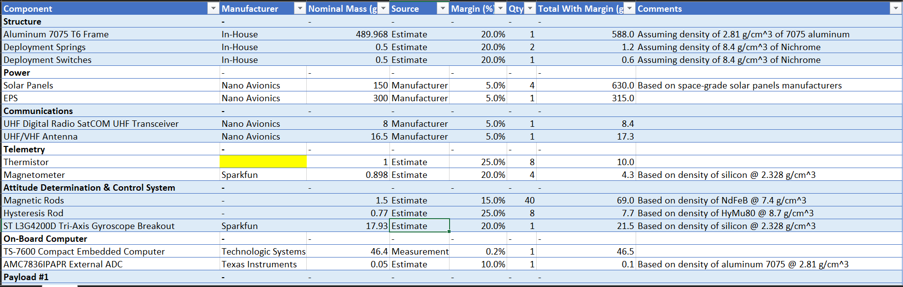
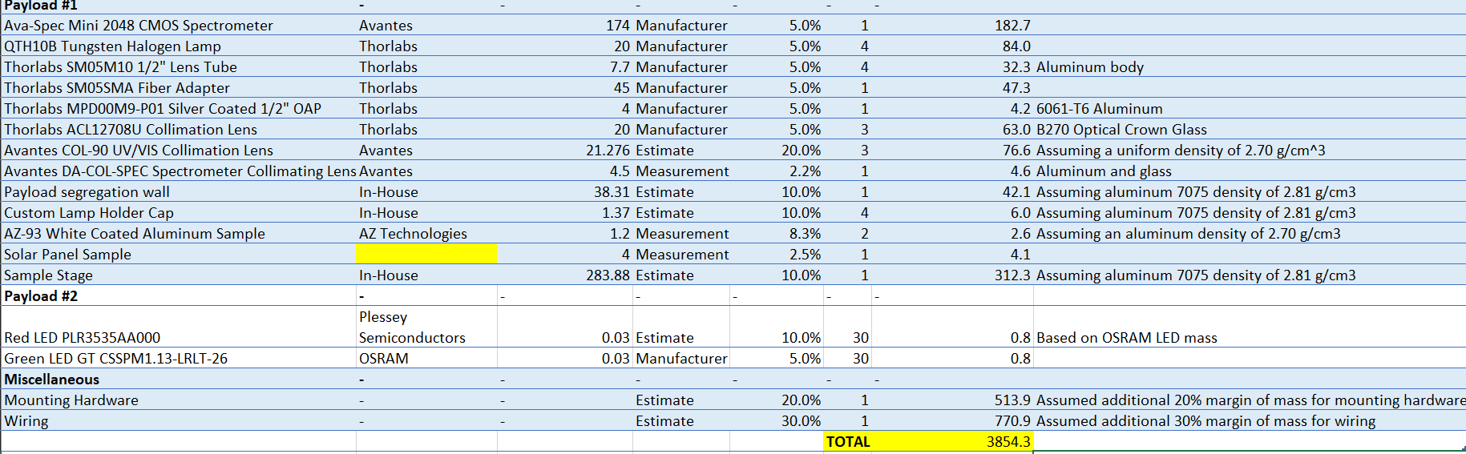
Mass Budget

Slide 49
Thermal Analysis

Slide 50
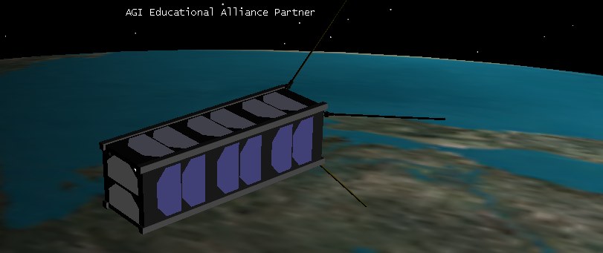

Thermal Analysis
Direct Solar
Earth IR
$$q_{out}$$
Albedo
Internal Sources | Sinks
Batteries/EPS | Primary/Secondary Structure
CDH/Transceiver | Radiation to space
Spectrometer
Tungsten Halogen Bulbs
Panel LEDs

Slide 51
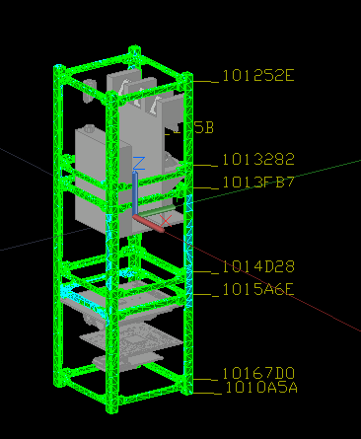
Thermal Analysis: Set-Up
Spectrometer
Lens Trio
10 W Halogen Bulbs
EPS
OBC
Transceiver
Notes:
Mention neglected: magnets, LEDs

Slide 52
Thermal Analysis: Set-Up (Cont.)
Conduction and radiation (Monte Carlo Ray-Tracing)
Tetrahedron mesh
Can simulate any beta angle, solar flux, Earth IR, etc.
Conduction and radiation contacts between internal components inner secondary structure
EPS/Batteries | -40°C / +85°C
Spectrometer | 0°C / 50°C
OBC | -20°C / 70°C
Transceiver | -40°C / +85°C

Slide 53
Thermal Analysis: Case Study
Source | Payload 1 Case | Hot Case | Cold Case
Sun | 0 W/m² | 1428 W/m² | 0 W/m²
Albedo | 0 | 0.37 | 0
Earth IR | 150 W/m² | 350 W/m² | 150 W/m²
Beta Angle | - | 0° | -
TS-7600 | 0.5 W | 1.2 W | 0.25 W
EPS | 0.16 W | 0.16 mW | 0.16 W
Transceiver | 0 W | 2.805 W | 0 W
Spectrometre | 3.75 | 0 W | 0 W
Halogen Bulbs | 10 W | 0 W | 0 W

Slide 54
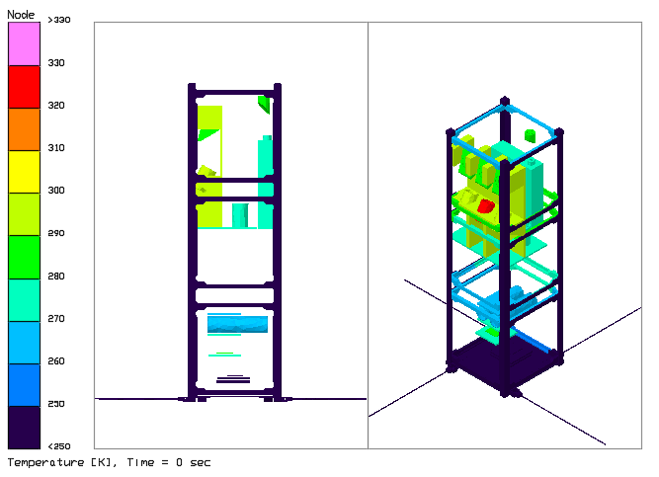




Thermal Analysis: Steady-State Payload 1 Mode
$$T_{spec}=280 K$$
$$T_{trans}=245 K$$
$$T_{OBC}=284 K$$
$$T_{batt}=269 K$$

Slide 55





Thermal Analysis: Steady-State Hot Case
$$T_{spec}=336 K$$
$$T_{batt}=329 K$$
$$T_{trans}=358 K$$
$$T_{OBC}=327$$

Slide 56





Thermal Analysis: Steady-State Cold Case
$$T_{spec}=208 K$$
$$T_{batt}=266 K$$
$$T_{trans}=241 K$$
$$T_{OBC}=262 K$$
Notes:
If we are in a very cold orbit, and turn on the halogen lamps, the gradient could be detrimental

Slide 57
Thermal Analysis: Temperature Margins
Component | Payload 1 Case | Hot Case | Cold Case
Spectrometre | 7°C | +13°C | -65°C
Transceiver | 12°C | 16°C | 8°C
Batteries | -3°C | 29°C | -7°C
TS-7600 | 31°C | 0°C | 9°C
MLI may be required for spectrometre

Slide 58
Power Sub-system

Slide 59

Power Sub-system: Block Diagram

Slide 60

Power Sub-system: Block Diagram

Slide 61


Power Sub-system: Power Generation
Battery info:
2 li-ion 18650 cells
3.7V each or 7.4V open circuit
3200mAh or 23,000 Wh capacity
Max unregulated output: 25W (at 7.4V)
Max regulated output: 20W
Largest DOD: 78%
-Physical Specs: 18.6(D) x 65.2(L) mm cylinder
-2x this for total package size ~38(W)x19(H)x65(L)mm
Orbit info:
LEO ISS orbit
Orbit length (hrs): 1.54
Sunlight hours per orbit: 0.96
Orbit Average Power: 4.3W
Power Regulation:
4 regulated, OC protected buses:
3.3V
5V
2X 2.7V-18V (configurable)
Configure to 12V for Payload1
Power distribution through PC104 connector
PV info:
+X,-X,+Y faces custom panel: 6X Azur cells [6S1P: 14.1V, 0.47A] (30%)
-Y face custom panel: 4X Azur cells [4S1P: 9.4V, 0.47A] (30%)
+Z face custom panel w. 2X Azur cells [2S1P: 4.7V, 0.47A] (30%)

Slide 62
Power Sub-system: Power Budget

Slide 63
Attitude & Orbit Determination & Control (AODC)

Slide 64
ADCS Papers
Rawashdeh S., (2010) “PASSIVE ATTITUDE STABILIZATION FOR SMALL SATELLITES”
B. M. Menges., C. A. Guadiamos, E. K. Lewis., "Dynamic Modeling of MicroSatellite Spartnik’s Attitude." 1998. 36th AIAA Aerospace Sciences Meeting and Exhibit
Tanaka T., (2015), “Overview and Operations of CubeSat FITSAT-1 (NIWAKA) ”
Virk R., (2012), "Modular Sun Sensor System for Orbital Attitude Determination“
Gerdhart, D. T., (2014), “Small Satellite Passive Magnetic Attitude Control”
A. Farrahi, A. Sanz-Andrés, (2013), "Efficiency of Hysteresis Rods in Small Spacecraft Attitude Stabilization”
N. Nakaya, K. Konoue, H. Sawada, et al., (2003), “Tokyo Tech CubeSat: CUTE-I - Design & Development of Flight Model and Future Plan”

Slide 65
ADCS Overview
Pointing Accuracy
Preferred orientation for COSMOSat -Z face towards Earth
LEDSAT must have array pointed towards Kingston when overhead (44.23 latitude)
LED array has a spread of 120°; 60° desired
MATLAB
Working to replicate results from Rawashdeh (2010), Menges (1998) and Gerdhart (2014)
Implement EOM to simulate de-tumbling response and orbital stability
Rawashdeh S,(2010) “PASSIVE ATTITUDE STABILIZATION FOR SMALL SATELLITES”
B. M. Menges, C. A. Guadiamos, E. K. Lewis., "Dynamic Modeling of MicroSatellite Spartnik’s Attitude." 1998. 36th AIAA Aerospace Sciences Meeting and Exhibit

Slide 66
ADCS Overview
Attitude Sensors
Sun sensing: Coarse (Solar Panel), Fine (Custom enclosed photodetector array)
Triaxial MEMS Gyroscope:
Drift error accumulates over time
Magnetometers: Verify ACS, attitude from external field
Attitude Control
Array of high strength magnets will provide passive control
Hysteresis rods damp out any off-axis rotation
De-tumbling operation requires no computational effort

Slide 67


Modelling Tools
Can estimate current and future attitude near steady state, updating ground model with telemetry
ADCS models in development (MATLAB) to evaluate design
Planned torque models:
Hysteresis material
Magnetic material
Aero torque
Gravity gradient

Slide 68

ADCS Control System
Dynamic attitude
Attitude is a function of instantaneous orbit position and associated magnetic field lines
During Kingston flyover, magnetic vector pointed westward and towards earth’s surface
Near critical damping to prevent overshoot
N
S

Slide 69
Attitude Sensor #1
Gyroscope: ST L3GD20
Difficult to measure such low rotation rates, useful during the detumbling phase
Digital zero-rate level >10 dps; other sensors offer ±1 dps
Drifts over time as error accumulates
Failure does not significantly affect design goals
Gyroscopes used previously in CubeSat designs (CUTE-I, 2003)
Notes:
Image: CUTE-I sensor board

Slide 70

Attitude Sensor #2
Custom Sun Sensor
Photodiode array with pinhole
Expected accuracy of roughly ±0.3°
Most consistent system, only works for half the orbital period
Updated infrequently due to heating requirements
Albedo of Earth and Moon may produce confusing results
Requires sensor to be an side facing the sun at max ±45° range
Failure significantly reduces AD accuracy

Slide 71

Attitude Sensor #3
Magnetometer: MAG3110
Requires calibration to reduce hysteresis rod and permanent magnet effects
Verify performance of passive system
Testing
Helmholtz cage planned to calibrate
sensors and test passive system
Rotation platform used to demonstrate
damping and alignment ability
Image: Gerdhart, D. T., (2014), “Small Satellite Passive Magnetic Attitude Control”

Slide 72
Attitude Determination Truth Table
Gyroscope | Magnetometer | Sun Sensor | Overall accuracy (deg)
✔ | ✔ | ✔ | 1
✘ | ✔ | ✔ | 2
✘ | ✘ | ✔ | 1 or N/A
✔ | ✘ | ✔ | 1 or 10
✔ | ✘ | ✘ | N/A
✔ | ✔ | ✘ | 4
✘ | ✔ | ✘ | 5
✘ | ✘ | ✘ | N/A

Slide 73


Attitude Actuators
Permanent Magnets:
Alnico-5 or neodymium cylindrical magnets placed along rail interior
Total strength of 1.5 Am² per end (magnetic moment)
Based off of Rawashdeh paper, currently determining from our calculations
Capable of tracking magnetic field within hours of deployment ^{[1]}
Failsafe
Low probability of system not performing
Attitude sensor input not necessary
No power requirement
[1] Rawashdeh S,(2010) “PASSIVE ATTITUDE STABILIZATION FOR SMALL SATELLITES”
Notes:
A. Farrahi, A. Sanz-Andrés, (2013), "Efficiency of Hysteresis Rods in Small Spacecraft Attitude Stabilization"

Slide 74
Attitude Actuators
Hysteresis Rods
Need sufficient material to damp rotation about Z-axis
Too much can increase steady state error (lag) during orbits and interfere with LEDSAT operation
8 rods/bars is typical to achieve damping in a wide variety of angles (TRANSIT-2A/1B, TNS-0/TEKh-42, KySat-1)
Material | HuMu80
Volume | 0.70 cm³
Coercivity | 1.59 A/m
Remanence | 0.35 Tesla
Saturation | 0.73 Tesla
[1] Rawashdeh S,(2010) “PASSIVE ATTITUDE STABILIZATION FOR SMALL SATELLITES”

Slide 75
Communications Systems

Slide 76
Communications System – Summary
Uplink and downlink will be operating at 437 MHz
Uplinks will be used to change the satellite mode
Downlinks will be used to issue replies and download collected data
All calculations for communications were based on using the Royal Military College of Canada's setup base station

Slide 77


Communications System: Satellite Hardware
Nano Avionics UHF Antenna System and UHF Radio
NA-RFS-G1-R2 and NA-UHF-G0-R0
9600 bit/s UART communications through radio
4 monopole antenna array matched to the radio
Images taken from Nano Avionics datasheets

Slide 78

Communications System: Base Station Hardware
RMC a dual polarity Yagi-Uda antenna with 15dBi of gain and tracking
75W of transmit power
9600 bps transceiver

Slide 79

Communications: Link Budgets

Slide 80

Communications: Data Sources – Deployment Mode

Slide 81

Communications: Data Sources – Default Mode

Slide 82

Communications: Data Sources – Communication Mode

Slide 83

Communications: Data Sources – Payload 1 Mode

Slide 84

Communications: Data Sources – Payload 2 Mode

Slide 85
Communications Throughput Budget
Each of the previous 5 modes are mutually exclusive
The most data intense mode, at 9600 baud, 1.5 minutes of downlink time will be needed per day

Slide 86
Command and Data Handling (C&DH) Sub-system

Slide 87
Papers
• TS-7600 Specs: https://wiki.embeddedarm.com/wiki/TS-7600
•Programming Language: https://www.activestate.com/blog/2016/09/python-vs-cc-embedded-systems
•Triple Modular Redundancy: https://www.isa.org/standards-and-publications/isa-publications/intech-magazine/2003/october/more-is-always-better-when-its-critical/

Slide 88

C&DH Architecture

Slide 89
Programming Language: Selection Process
PYTHON | C
High-level language; requires Hardware Abstraction Layer (HAL) to interface with embedded system; removes overhead | Mid/low level language; can be customized to work with any hardware out of the box (access memory registers directly using pointers)
Simpler language, readable; often faster creation time | Harder to read; often longer creation time
Slower runtime | Compact file sizes & faster runtime
No HAL available for the TS-7600; would require more code and time | Sample code for the TS-7600 is provided in C
Dynamically interpreted: more likely errors will occur during compilation | Statically interpreted

Slide 90

Software Architecture

Slide 91

Uplinked Commands
Command library – one file for each command

Slide 92

Onboard Computer (TS-7600)
CPU | ARM, 454 MHz
RAM | 256 MB
Storage | 8 MB (Onboard), 2 microSD Sockets
Data Acquisition & Control | 55 Digital IO, 4 ADC pins
Interfaces | 10/100 Ethernet 2x USB 8x Serial/COM ports 1x SPI 1x I2C 1x CAN
Onboard Devices | RTC, WDT, Temp. Sensor
Operation Temperature | -20 °C to 70 °C
Power Consumption & Supply Voltage | 1.20 W (Max), 5 VDC (OP)
Size | 74 mm x 66 mm

Slide 93
Assembly, Integration, and Test (AI&T)

Slide 94
Mechanical
Test | Description | Involved Subsystems | Start Date | End Date
Deployment | Ensure TS-7600 and EPS power on when switch is released; Test TS-7600 timer prior to antenna deployment | TS-7600, EPS | Oct-2017 | Dec-2017
Vibration Testing* | Simulate launch sequence natural modules with vibration table | Primary and Secondary Structure | Oct-2017 | Dec-2017
Thermal Vacuum Testing** | Operate basic functions in vacuum and low/high temperatures-depending on securing sufficient chamber | All | Mar-2018 | April-2018
*Shaker table at Queens available.
**Vacuum chamber at RMC to be used.

Slide 95
Electrical - Power
Test
Description
Involved
Start Date
End Date
Subsystems
Solar Panel PCB
Eagle
Software to develop
Structure,
integration to structure and
EPS, LEDs
Oct-2017
Feb-2018
Design and Testing
EPS
PCB Outgas Test and Electrical Performance
Place PCBs in vacuum
chamber (IGPR),
measure
EPS
Jan-2018
Feb-2018
mass before and after
Output Power
Ensure power consumption
Consumption data
data can be output and
All
Oct-2017
Dec-2017
recorded
Experimentally verify
Battery Curves
battery cycle
curves,
EPS
Jan-2018
Feb-2018
charge/discharge
rates

Slide 96
Electrical – ACDS / Telemetry
Test | Description | Involved Subsystems | Start Date | End Date
Hysteresis Rod/Magnet Test | Experimentally verify decay rates of tumbling in Helmholtz coil | Hysteresis material, Permanent magnets | Oct-2017 | Nov-2017
Solar Cell Attitude Determination | Verify solar cells can identify pointing direction | EPS, TS-7600, Solar Array | Feb-2018 | Feb-2018
Calibration | Ensure measurement systems correlate with data sheets (magnetometer, gyroscope, thermocouples) | TS-7600, Telemetry sensors | Oct-2017 | Nov-2017
Telemetry | Use OBC to collect analog data through ADC | All | Jan-2018 | Mar-2018

Slide 97
Electrical – Communications / CDH
Test | Description | Involved Subsystems | Start Date | End Date
Antenna Release Mechanism | Verify burn wires capable of releasing antenna array upon deployment | TS-7600, Antenna array, Structure | Oct-2017 | Dec-2017
Dummy Load Testing | Simulate sending of telemetry via transceiver without broadcasting of signal | Transceiver, Dummy antenna | Oct-2017 | Nov-2017
File Transfers | Package, transmit data to and from communication board | TS-7600, Comms | Nov-2017 | Dec-2017
Real-Time Clock | Gather data at given time intervals to validate reliability of RTC | TS-7600, Spectrometer | Oct-2017 | Nov-2017
Watchdog Timer | Ensure that the Watchdog Timer will reset the computer after a malfunction | TS-7600, EPS | Nov-2017 | Dec-2017
Operating Modes | Cycle through operating modes and ensure subsystems are capable of communicating with and being controlled by the CDH board | All | Jan-2018 | Feb-2018

Slide 98
LEDSAT
Test | Description | Involved Subsystems | Start Date | End Date
Wavelength Testing | Ensure LED wavelength can be measured using double-blind test | Arduino, LED Array | Oct-2017 | Nov-2017
Mode A Preliminary Testing | Use Arduino to alternate between LEDs on each panel | Arduino, LED Array | Oct-2017 | Oct-2017
Mode B Preliminary Testing | Use Arduino to transmit Morse code | Arduino, LED Array | Oct-2017 | Oct-2017
Mode A Testing | Alternate LEDs between panels and wavelength using TS-7600 | TS-7600, LED Array | Nov-2017 | Dec-2017
Mode B Testing | Use TS-7600 to transmit Morse code | TS-7600, LED Array | Nov-2017 | Dec-2017
PCB Testing | Basic functionality after PCB mounting | LED Array | Nov-2017 | Dec-2017
LED Power Draw | Ensure power consumption is within expected values | LED Array, EPS | Oct-2017 | Oct-2017

Slide 99
Spectrometer
Test | Description | Involved Subsystems | Start Date | End Date
Calibration | Ensure spectra when taken matches experimentally verified data. Calibrate light sensor criteria | Spectrometer and Optics, TS-7600 | Oct-2017 | Dec-2017
Take Spectra & Reconstruct Data | Take spectra and able to recreate the ADU spectra from raw spectrometer data | Spectrometer and Optics, TS-7600 | Oct-2017 | Dec-2017
Repeatability | Determine typical variance in spectra under constant conditions | Spectrometer and Optics, TS-7600 | Dec-2017 | Jan-2018
Specular Illumination Lobe | Determine angular lobe for each sample initially | Bédard's Goniometer experimental set-up | Nov-2017 | Dec-2018
Model SED of Lamp | Construct a before and after irradiation SED of a QTH10B bulb | “” | Oct-2017 | Oct-2017
Spectral Collection Parameters | Determine optimal integration time - large enough to differentiate from noise, small enough to not saturate detector | Spectrometer and Optics, TS-7600 | Oct-2017 | Nov-2017
Build and Integrate Baffles and Iris | Create a point source. Will also need to collect this light source as the "true representation" of our light in the optical system | Structure | Nov-2017 | Dec-2018

Slide 100
Initialization Sequence
Test | Description | Involved Subsystems
Deployment | Release of rail switch boots EPS, initialization of TS-7600, antenna deployment | Structure, EPS, TS-7600, Antenna
LEDSat Beacon | Upon collection of sufficient power from solar array, begin LEDSat beacon (dependent on current bus status) until comms have been established | Solar Array, EPS, LED Array, TS-7600
Telemetry | Collect and save telemetry at specified frequencies, broadcast presence over communications system | Telemetry sensors, TS-7600, Communications, EPS
Handshake | Establish data link between ground station and satellite | TS-7600, Communications, EPS
Run COSMOSat | After communications have been established, permission is granted to gather and save spectra based on orbital position/desired frequency | Spectrometer, optics, TS-7600, EPS
Payload continuation | Collection of scientific data from COSMOSAT, upload settings for Mode B of LEDSAT | LED Array, TS-7600, EPS

Slide 101
Programme Management

Slide 102

Program Schedule
Critical Path

Slide 103
Program Budget - Hardware
Communications | Transceiver | Budgeted | NanoAvionics | $6,744.47
 | Dummy Load | Budgeted | Mouser | $91.07
 | Antenna | Budgeted | NanoAvionics | $4,153.88
EPS | Power Distribution System | Budgeted | NanoAvionics | $4,984.43
 | PCBs | Budgeted/Estimated | AP Circuits | $877.28
 | Solar Cells | Actual | Azur | 8081.71
Thermal | Multi-Layer Insulation | Actual | Dunmore | $700.60
 | Heater Design Kit | Actual | Minco | $277.98
Structure | Aluminum 7075 T6 | Budgeted | McMaster-Carr | $512.00
 | Hardware | Estimated |  | $50.00
 | Deployment Springs | Estimated |  | $56.50
 | Deployment Switches | Estimated |  | $113.00
Telemetry | Thermistor | Estimated |  | $204.48
ADCS | Magnetometer | Budgeted | Elmwood Electronics | $56.16
 | Gyroscope | Budgeted | Sparkfun | $80.44
 | Magnetic Rods | Budgeted |  | $45.00
 | Hysteresis Rods | Budgeted |  | $150.00
OBC | External ADC | Budgeted | TI | $41.89
Spectrometer | Silver Coated 1/2" Off-axis parabolic mirror | Budgeted | Thorlabs | $223.58
 | Collimation Lens | Budgeted | Thorlabs | $63.77
 | 90 degree Collimation Lens | Budgeted | Avantes | $573.75
 | Payload Segregation Wall | Estimated | In-house | $0.00
 | Custom Lamp Holder Cap | Estimated | In-house | $0.00
 | Sample Stage | Estimated | In-house | $0.00
LEDSAT | Green LEDs | Budgeted | Mouser | $107.24
 | Red LEDs | Budgeted | Mouser | $99.89
 |  |  | TOTAL | $29,226.83

Slide 104
Program Budget – Other Costs
Structure | Machining | Primary and Secondary Structure Fabrication | Queens University | $40.00 | 15 | $0.00 | $0.00 | 1 | $600.00
 | Hard Anodizing | Four Type III hard-anodized Al 7075-T6 Rails | Waterloo Electroplating | $90.00 | 1 | $0.00 | $0.00 | 1 | $90.00
ADCS | Solar Panel Attitude Determination | Required: 3D printed mount and Arduino DAQ |  | $90.00 | 1 | $0.00 | $0.00 | 1 | $90.00
 | PSD and pin-hole testing | Required: aluminum pin-hole structure |  | $0.00 | 1 | $0.00 | $0.00 | 1 | $0.00
 | Magnetic/Hysteresis Rod Testing | Large aluminum frame, copper coils for Helmholtz coil, fidget spinners |  | $0.00 | 1 | $0.00 | $0.00 | 1 | $0.00
EPS | Battery Testing | 18650 Li-ion battery testing | Elmwood Electronics | $9.99 | 5 | $10.00 | $0.00 | 1.13 | $66.44
Hardware/Wiring |  | Estimated |  | $601.46 | 1 | $0.00 | $0.00 | 1 | $601.46
 |  |  |  |  |  |  |  | TOTAL | $1,447.90

Slide 105
Program Budget – Project Income
Based on last year
Dean's Donation (fall 2016) | $15,000.00 | October-24-16
QYEA cheque | $2,135.00 | November-04-16
Student Activity Fees (90%) | $7,702.71 | November-09-16
Sponsorship Cheques - Aversan and Thorlabs | $1,000.00 | November-20-16
Sponsorship Cheques - MDA | $500.00 | December-03-16
Shell Activity Fund | $5,000.00 | December-03-16
QYEA cheque | $1,000.00 | March-09-17
Dean's Donation (winter 2017) | $15,000.00 | March-17-17
Sponsorship cheque | $2,000.00 | March-21-17
Sponsorship Cheque- GASSI | $5,000.00 | March-24-17
Student Activity Fees (10%) | $829.36 | April-21-17
Shell Activity Fund | $5,000.00 | May-11-17
TOTAL | $60,167.07

Slide 106
Project Risk Management
Team Dynamics
QSET is an open-access team
Potential difficulties in ensuring deadlines are met
Knowledge gap
First time @ CSDC
Significant time spent in learning curve
Mitigation using wiki and through mentorship culture of team
Facility and Equipment Access
Highly dependent on partnership with professors at Queen’s University and Royal Military College for lab usage
OBC development
Critical path in development

Slide 107
Payload Risk Management Analysis at PDR
Failure Mode | Cause | Mitigation Method
Spectrometer Damage | Dislodge at launch Debris impact Radiation Vibration misalignment Thermal | Shielding AvaSpec Mini used in environmental research (ruggedized for vibration)
Degradation of Optics | Radiation | Shielding, sample redundancy, reference sample
Dislodged Optics | Vibration Thermal | Plate-mounted lenses, sample Redundancy
Notes:
Degradation of Optics: Space Radiation (Potential Loss of Signal through optical assembly)
Dislodged Optics: Dislodge from launch, Vibrations from orbit, Impact from Debris
POSSIBLE OTHERS THAT DON’T FALL UNDER “DAMAGE”: Changes to internal gratings due to temperature fluctuations

Slide 108
Updated Payload Risk Management Analysis
Mode | Effect | Mitigation
Vibration | Optics misalignment Detachment of mounts | Monolithic design reduces components and limits movement Low-outgas epoxies to secure components
Thermal | Thermal warping Detector noise | Metal components have matched thermal expansion Low-expansion fused silica optics Temp. sensor check prior to payload
Radiation | Burnout of CMOS Detector drift | Free-space optics reduces degradable components CMOS detector less susceptible than CCD to charge buildup
Light | Burnout of CMOS | Operation in eclipse On-board lighting
Power | Unable to complete task | EPS
Comms | Unable to transmit Data corruption | Payload 2 system Parity bit check

Slide 109
Mitigation of Payload Error
Noise | Effect | Mitigation
Radiation | Changing light SED Degradation of optics and spectrometer Corruption of data | Reference lamp and background sampling Enclosed design reduces exposure CDR testing to quantify effects Record multiple spectra per test Triple modular redundancy in storage
Stray Light | Noise in CMOS | On-board lighting Operation in eclipse Record background @ test
Thermal | Noise in CMOS Aberrations | Operation only during narrow temperature range Record temperature @ test
Light Stability | Noise in CMOS Changing light SED | Let lamp equilibrate before sampling Vacuum chamber and CDR tests to quantify effects Record multiple spectra per test

Slide 110
Concept of Operations (CONOPS)

Slide 111

Concept of Operations: Overview

Slide 112

Concept of Operations: LEOP and Default Mode

Slide 113
Concept of Operations: Payload 1

Slide 114

Concept of Operations: Payload 1

Slide 115
Concept of Operations: Payload 2

Slide 116

Concept of Operations: Payload 2

Slide 117

Concept of Operations: Payload 2A
Satellite is tumbling
LEDs of given wavelength on each panel are held on for 20 s, then switch to the next panel
Command
red
Wait 20 sec
+x panel
green
Command
red
+y panel
green
red
-x panel
green
red
-y panel
green

Slide 118


Concept of Operations: Payload 2B
Satellite has stabilized
[-z] points within ${60}^{o}$ of Kingston while overhead
Morse code message, which was uplinked, is transmitted using selected LEDs

Slide 119
Concept of Operations: Nominal Timeline
Mode | Event Name | 0:00 |  | 0:30 |  | 1:00 |  | …. | 3:00 |  | 3:30 |  | …. | 8:00 |  | 8:30 |  | 9:00 |  | 9:30
Deployment | Deployed
 | Power On
 | Read/Record Time and Boot Count
 | Deploy Antenna
Default Mode | Query Receiver
 | Transmit Telemetry
 | Uplink: Enter Communications Mode
Communications Mode | Access Telemetry
 | Uplink: Command Continous transmission
 | Transmit Data (1 Hz)
 | Enter Default Mode
 | Ground Ops: Check sensor calibration, satellite orientation, satellite health
Default Mode | Query Receiver
 | Transmit Telemetry
 | Uplink: Enter Communications Mode
Communications Mode | Access Telemetry
 | Uplink: Command Continuous Transmission
 | Transmit Data (1 Hz)
 | Enter Default Mode
 | Ground Ops: Check sensor calibration, satellite orientation, satellite health
Default Mode | Query Receiver
 | Transmit Telemetry
 | Uplink: Enter Communications Mode
Communications Mode | Access Telemetry
 | Uplink: Enter Payload 2A Mode in 95 min. Green LEDs, contact time of 7 minutes
 | Ground Ops: Check telemetry, prepare telescopes
LEOP

Slide 120
Concept of Operations: Nominal Timeline
Mode | Event Name | 8:30 |  | 9:00 |  | 9:30 |  | 10:00 |  | 10:30 |  | 11:00 |  | 11:30 |  | 12:00 |  | ….. | 19:00 |  | 19:30 |  | … | 21:00 |  | 21:30
Default Mode | Query Receiver
 | Transmit Telemetry
 | Enter Payload 2A Mode
Payload 2A Mode | Verify satellite is in eclipse and power capacity is sufficient
 | Alternate through green LEDs
 | Ground Ops: SSM or TRM tracking of LEDs using filter & CCD
Default | Query Receiver
 | Transmit Telemetry
 | Uplink: Enter Communications Mode
Communications Mode | Access Telemetry
 | Uplink: Enter Payload 1 Mode 5 orbits from now
 | Downlink LED data. Ground Ops: Check LED power consumption, correlate to brightness
Default Mode | Query Receiver
 | Transmit Telemetry
 | Enter Payload 1 Mode
Payload 1 Mode | Verify satellite stray light is below threshold and power is sufficient
 | Activate lamp, take spectra, store data, power off
 | Enter Default Mode
Default Mode | Query Receiver
 | Downlink telemetry and science data
SCIENCE MODES

Slide 121

Payload #1: Sources of Error

Slide 122
Concept of Operations: Payload Anomalies
Mode | Detection | Response
Misalignment of optics | Significant decrease in light throughput | Continue operation on remaining samples Attempt sampling in sunlight
Thermal warping | Spectral drift Temp. measurements | Tighten thermal constraints Post-processing correction
Stray light | Unexpected spectral features Increased noise floor Background spectra Sun sensors | Tighten ambient light constraints Post-processing correction
Detector response drift | Reference and background spectra | Post-processing correction Allow time for passive discharge if possible
Optical aberrations | Ghost images in spectrometer Decreased light throughput | Post-processing correction

Slide 123
Concept of Operations: Payload Anomalies (cont.)
Mode | Detection | Response
CMOS noise | Inconsistent unexpected spectral feature Drift | Increased sampling Post processing correction
Unable to transmit | No data received Timeout No 'data received' signal | Re-attempt on next cycle
Internal comms. noise | Increased data noise floor | Triple modular redundancy Manual filtering on ground
Burnout of CMOS | No spectral data | Re-attempt on next cycle
Power failure | EPS query | Re-attempt on next cycle
Data corruption | Triple modular redundancy error log | Increase sampling rate Adjust orbit location during sampling to avoid radiation hotspots

Slide 124
Concept of Operations: CDH Anomalies
Mode | Detection | Response
Single event latch-up | Watchdog timer fails to reset | Timeout signal is sent to initiate power cycle (WDT)
Unable to transmit | Timeout No 'data received’ signal | Re-attempt on next cycle
Internal comms. noise | Increased data noise | Triple modular redundancy
Power failure | Watchdog timeout signal | Initiate power cycle

Slide 125
Concept of Operations: CDH Anomalies
Mode | Detection | Response
Data corruption | Triple modular redundancy error log | Flag data files with multiple errors to inspect Send these data files to earth If needed, can use system restore command to go back to a previous state; second duplicate SD card will also have the OS installed (RAID1)
Out of memory storage | Unable to save files OS will detect this | Dump old data to earth on next comms window
Program not responding | Timeout | Timeout signal sent to restart program; re attempt process on next cycle

Slide 126
Educational Outreach

Slide 127



Science Quest (SQ) – March 2017
Summer & school-year camp with gr. 1 – 8 students in Kingston, with ~20 campers in each group.
QSET has done workshops with SQ over the last few years with their various camp programs
Notes:
https://sciencequest.ca/clubs-photos-2016-2017/
Please summarise the Educational Outreach presentations you have given
Locations, approximate number of people, any local media coverage

Slide 128


Science Rendezvous (Kingston) – May 2017
Science Rendezvous is an annual Canada-wide event bringing people in STEM fields to present in their communities
QSET presented their decade of work in space-related technologies to hundreds of students and families in the Kingston area.
Local media and Science Rendezvous organizers were present at the event

Slide 129


Other Outreach
Orientation week showcase on Queen’s campus to ~700 first-year engineering students Sept. 2016 and 2017
Presented to representatives from GM during a design team visit in the fall 2016
High school students toured our workspace where we displayed our ongoing projects
Showcased work at the 2016 Queen’s Space Conference to ~150 attendees and presenters
Publicly documents all team work on QSET webpages (www.qset.ca and qsat.wikidot.com)

Slide 130
Summary

Slide 131
Summary – Accomplishments
General
Partnered with RMC for ground station access
Payloads
Incorporation of multiple payload capabilities
Payload 1: Collection of spectral BDRF of three samples and one reference
Payload 2: LED visual communication on satellite exterior
Robust design allows functionality under broad conditions
Structure & Thermal
CAD model ready for prototyping
Models predict viable thermal operation and vibrational integrity
Overall 3.9 kg mass (incl. margin)

Slide 132
Summary – Accomplishments (cont.)
Power & Communications
Designed EPS system to handle power requirements of payload
ADCS & CDH
Passive ADC system greatly simplifies overall satellite controls
CDH architecture can identify and correct single-bit flips
Designed and currently testing data transfer, error detection and handling, and watchdog systems
Outreach
Wide variety of outreach projects, building relationships with local schools and camps to provide educational workshops
Plans to continue relationship with ScienceQuest, Science Rendezvous, and the Engineering Society of Queen’s University

Slide 133
Summary – Next Steps and Required Assistance
Overall
Test initialization procedure
Access to vacuum chamber; no facility for thermal testing
Management of risk in team dynamics
Shift from design phase into system construction and testing
Payload
Simulate lab results
Calibration and post-processing procedure
Morse code transmission with LED
Structure & Thermal
Battery heating/lamp cooling tests
Manufacture and prototype to confirm models
Notes:
Why we are ready for the next stage of development?
This is our team’s first year in this competition – although we have limited physical construction as of this date, our focus on robustness in design allows us to save time down the line and assemble/test our systems in time for the April final thermal vacuum/vibration testing

Slide 134
Summary – Next Steps and Required Assistance
Power & Communications
Design solar panel PCB & test outgassing
Determine battery cycle curves & confirm power usage
ADCS
Model sun sensing capabilities
Test tumbling decay rates in Helmholtz cage
Calibration
CDH
Dummy load testing
Ensure watchdog and error-correction functionality

Slide 135
Supplementary Information

Slide 136
Testing Objectives and Outcomes @ CDR
Exp. | Component | Testing Outcomes
1 | Quartz Tungsten Halogen Lamp | Observe changes in SED due to time based radiation
2 | Spectrometer | Observe changes in spectral response of the CMOS detector
3 | Onboard Computer | Observe changes in data transferred between computers
Collect SED of lamps before and after irradiation
Observe changes in SED, equilibration time, power, stability
Collect three reference spectra prior to irradiation, and again periodically during and after irradiation.
Observe changes in spectral shape and noise
Send text file with known data every 10 seconds, for an hour
Compare text files stored on irradiated CPU with file on PC
Notes:
Will determine what the lifetime of the bulb is when exposed to radiation: Good to know to get an idea of how many spectra we would be able to take
Data processing models assume a stable light source: Good to know if a “stable’ light source can be approximated
Spectral BRDF is a ratio therefore I don’t think it matters if the intensity of the light source changes???? Bigger deal if we want to track kinetics based on a spectral feature
Will provide integration times that are acceptable (I don’t think it matters what the integration time for BRDF) but would matter if we want to track kinetics based on a spectral feature
Spectrometer
Indicates any changes in spectral response: detector may become less/more sensitive to different wavelengths therefore some correction parameters may be necessary
2. Check on radiation+CMOS effects some more
1. Radiating the spectrometer
Ask James if there are any materials that we would be able to test to get an idea of how long it takes to see a noticeable change.

Slide 137
Payload 1 Background and Theory

Slide 138

Space Environment Material Degradation Experiments
VIS-NIR reflectance spectroscopy has been used to identify asteroid composition ^{[P4]}
Payload extends research by Bedard et al. to create a database of spacecraft material reflectance spectra ^{[P4]}
Material reflectance properties will change as they are bombarded in space ^{[P1, P2, P4]}

Slide 139

Data Collection in Ground-Based Experiments
As surface roughness increases the specular spike decreases
(specular-diffuse lobe increases) ^{[P5]}

Slide 140

Bi-directional Reflectance Distribution Function (BRDF)
BRDF model reflectance as a function of illumination geometry and wavelength ^{[P2]}
Materials exhibit unique BRDF based on surface structure, composition, and roughness ^{[P2]}
Time-series data collected will be used to extend existing models
Colour ratios of filtered spectra may also be used to classify materials ^{[P2]}
Notes:
$f_{r}\left(θ_{i}, θ_{r}, λ\right):$Spectral bidirectional reflectance distribution [sr⁻¹] $S_{r}\left(E_{i}, θ_{i},θ_{r}, λ\right):$Measured reflectance signal [ADU]
$S_{0}\left(λ\right),$Measured incident signal [ADU]
$t_{exp(r)}:$ Exposure time [s]
$t_{\exp\left(0\right)}$: Exposure time of reference signal [s]
$∆ω_{s}:$Solid angle of the detector [sr]
$θ_{i}$: Incident angle [degrees]
$θ_{r}:$Reflected angle [degrees]

Slide 141

Bi-directional Reflectance Distribution Function (BRDF)
BRDFs identify surface roughness through:
Reddening Effect
Increase in intensity of reflected red wavelengths ^{[P1, P2]}
Slope of the BRDF
Identified as a parameter that may be used to model orbital age ^{[P1, P2]}

Slide 142
Payload 1 Instrumentation and Design

Slide 143

CMOS Spectrometer (Avantes Ava-Spec Mini) ^{[P3]}
Selected for its light weight and small size
CMOS detector was selected over CCD variants due to less susceptibility to electron buildup on detector surface
Physical Specs. |  | Perform. Spec.
Weight | 174 g | Range | 200 – 1100 nm
Size | 9.5 x 2 x 6.5 cm³ | Resolution | 2.35 nm
Operating Temp. | 0 – 55 ºC | Connection | USB 2.0
Grating | 300 line/mm | Blaze | 300 nm

Slide 144


Quartz Tungsten Halogen Lamp (Thorlabs QTH10B) ^{[P6]}
Better output stability and more uniform spectral distribution over similar xenon-arc lamps
10W input power (@ 12 VDC)
400 – 2000 nm useful range
Must be cooled to prevent burn-out (i.e. conduction tape)
Notes:
Thorlabs Inc., “Quartz Tungsten-Halogen Lamp.” Thorlabs Inc., 2017.

Slide 145
Optical System Design
Design Element | Justification
Single observation angle at 60º incident/reflection | Maximum exposure of sample with minimum instrument exposure, while matching existing data Specular reflection provides most light for measurements
Free-space optics | Reduces degrade-able components and complexity
Samples housed inside exposed via slot | Protects sensitive instrumentation and removes need for moving deployment rigs
On-board lighting | Reduces attitude control needs and improves consistency as LEO orbits have rapid illumination geometry change Sunlight may be used as a back-up, opening possibility of additional illumination geometries

Slide 146
Payload 2 Background and Theory

Slide 147


Payload 2: Inverse-Square Law
Inverse-Square Law for an LED in orbit:
$$f= \frac{L}{2πd^{2}\left(1−\cos{θ_{1/2}}\right)}$$

Slide 148




Payload 2: LED Magnitude
$P_{out}=1 W$
$$θ_{1/2}={30}^{o}$$
$$M_{LED}=2.5\log\left(\frac{f_{sun}}{f_{LED}}\right)+M_{sun}$$

Slide 149

Payload 2: Luminous Efficacy of Radiation
Converting lumens (luminous flux) to Watts (radiant flux)
Must use this to specific power output from commercially-available LEDs
Source: http://www.ledsmagazine.com/articles/2005/05/metrics-for-solid-state-lighting.html

Slide 150


Payload 2: Trade Study
Trade-off between radiant flux and beam FWHM
$$d=1000 km$$

Slide 151




Payload 2: LED Selection
Wavelength
Green provides best visibility to human eye
Red provides high power and atmospheric penetration efficiency
Green LEDs:
Red LEDs:
$$P_{in}=1.17 W×6 LEDs \sim 7.0 W$$
$$P_{in}=1.05 W×6 LEDs \sim 6.3 W$$
$$P_{out}=1.5 W$$
$$P_{out}=2.2 W$$

Slide 152

Payload 2: LED Beam Pattern

Slide 153

Payload 2: STK Simulations
Assumed stabilized with LEDs nadir pointing
Access calculated over year-long space assuming ISS orbit, and that LEDs are only visible during eclipse
Notes:
- Large gaps due to offset in CoSMOSAT’s orbit time and the Earth’s rotation

Slide 154
Payload 2: Contact Times
January-February
July-August
Average Contacts per Day | 2.05
Average Total Contact time per Day | 276 sec
Average Time per Contact | 138 sec
Contact Period Length | 41 Days
Average Contacts per Day | 1.07
Average Total Contact time per Day | 111 sec
Average Time per Contact | 109 sec
Contact Period Length | 34 days

